Slide 1
Leadership
Dinesh sharma
Leadership: The ability to influence a group toward the achievement of a vision or a set of goals

Slide 2

https://www.youtube.com/watch?app=desktop&v=pODqT0P8VI4&ab_channel=MilkTeethTV
Notes:
https://www.youtube.com/watch?app=desktop&v=pODqT0P8VI4&ab_channel=MilkTeethTV

Slide 3
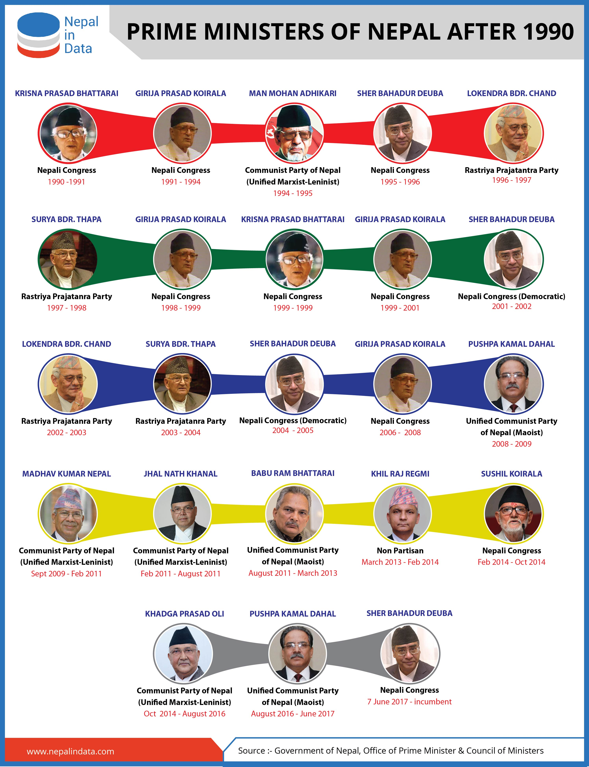

Slide 4
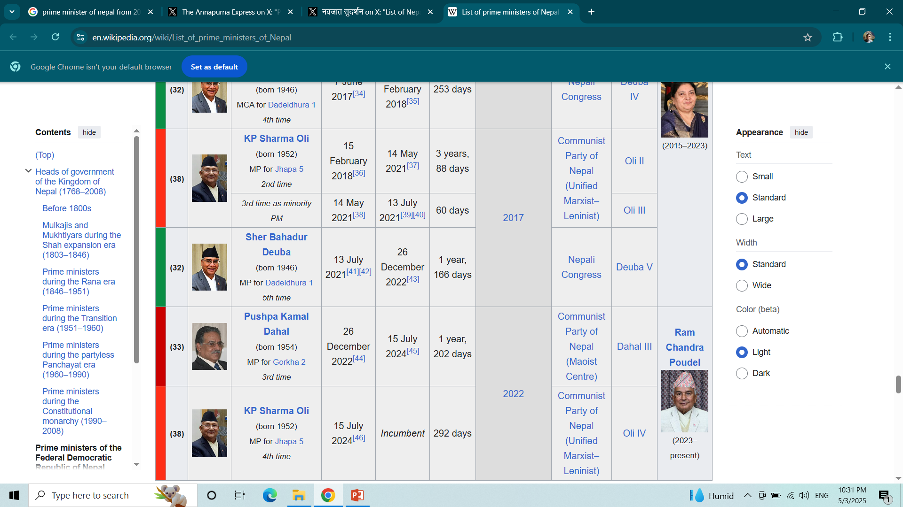

Slide 5

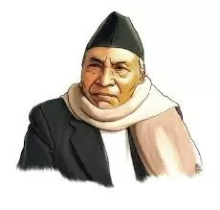
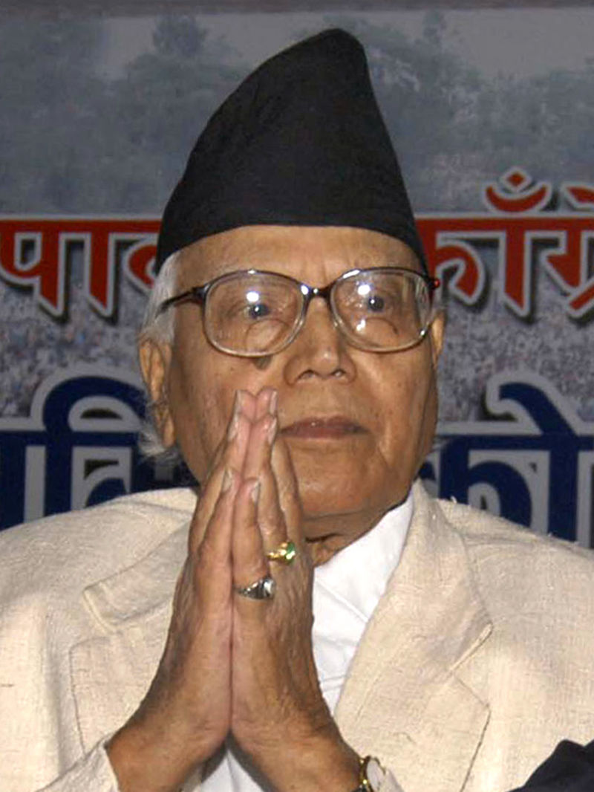
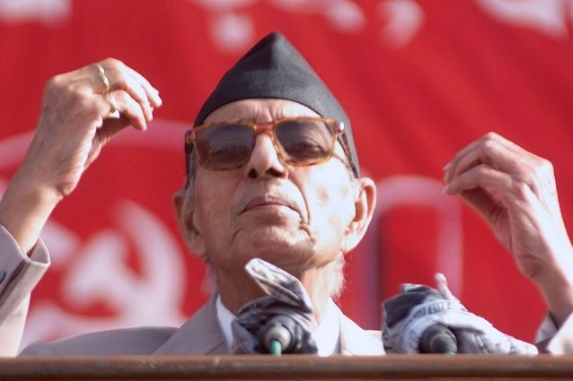
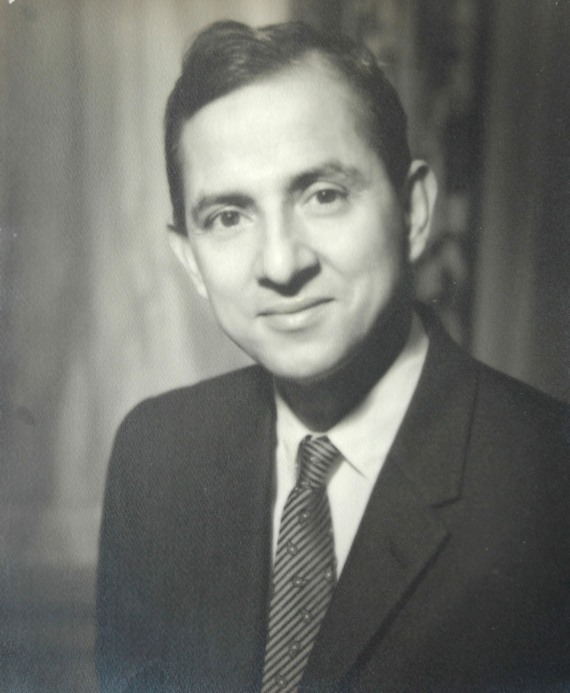
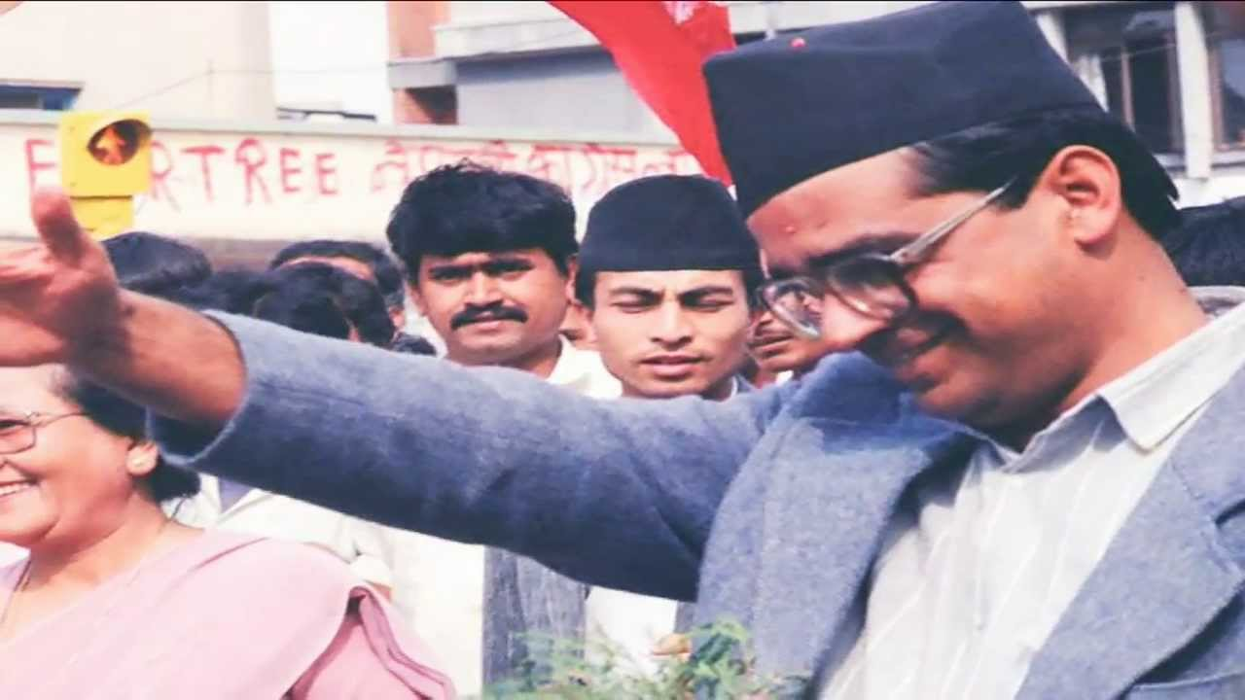
Krishna prasad Bhattrai
Ganesh Man Singh
Matrika prasad
Girija Pd. Koirala
Madhan bhandari
Notes:
https://www.imnepal.com/popular-leader-nepal-no-more-death/

Slide 6
Concept
Leadership is the art of influencing and inspiring the behaviour and activities of other in accordance with requirement.
“leadership is the activity of influencing people to strive willingly for mutual objectives.” -George R. Terry
“Leadership is the ability to influence a group towards achievement of goals.” - Stephen P. Robbins

Slide 7
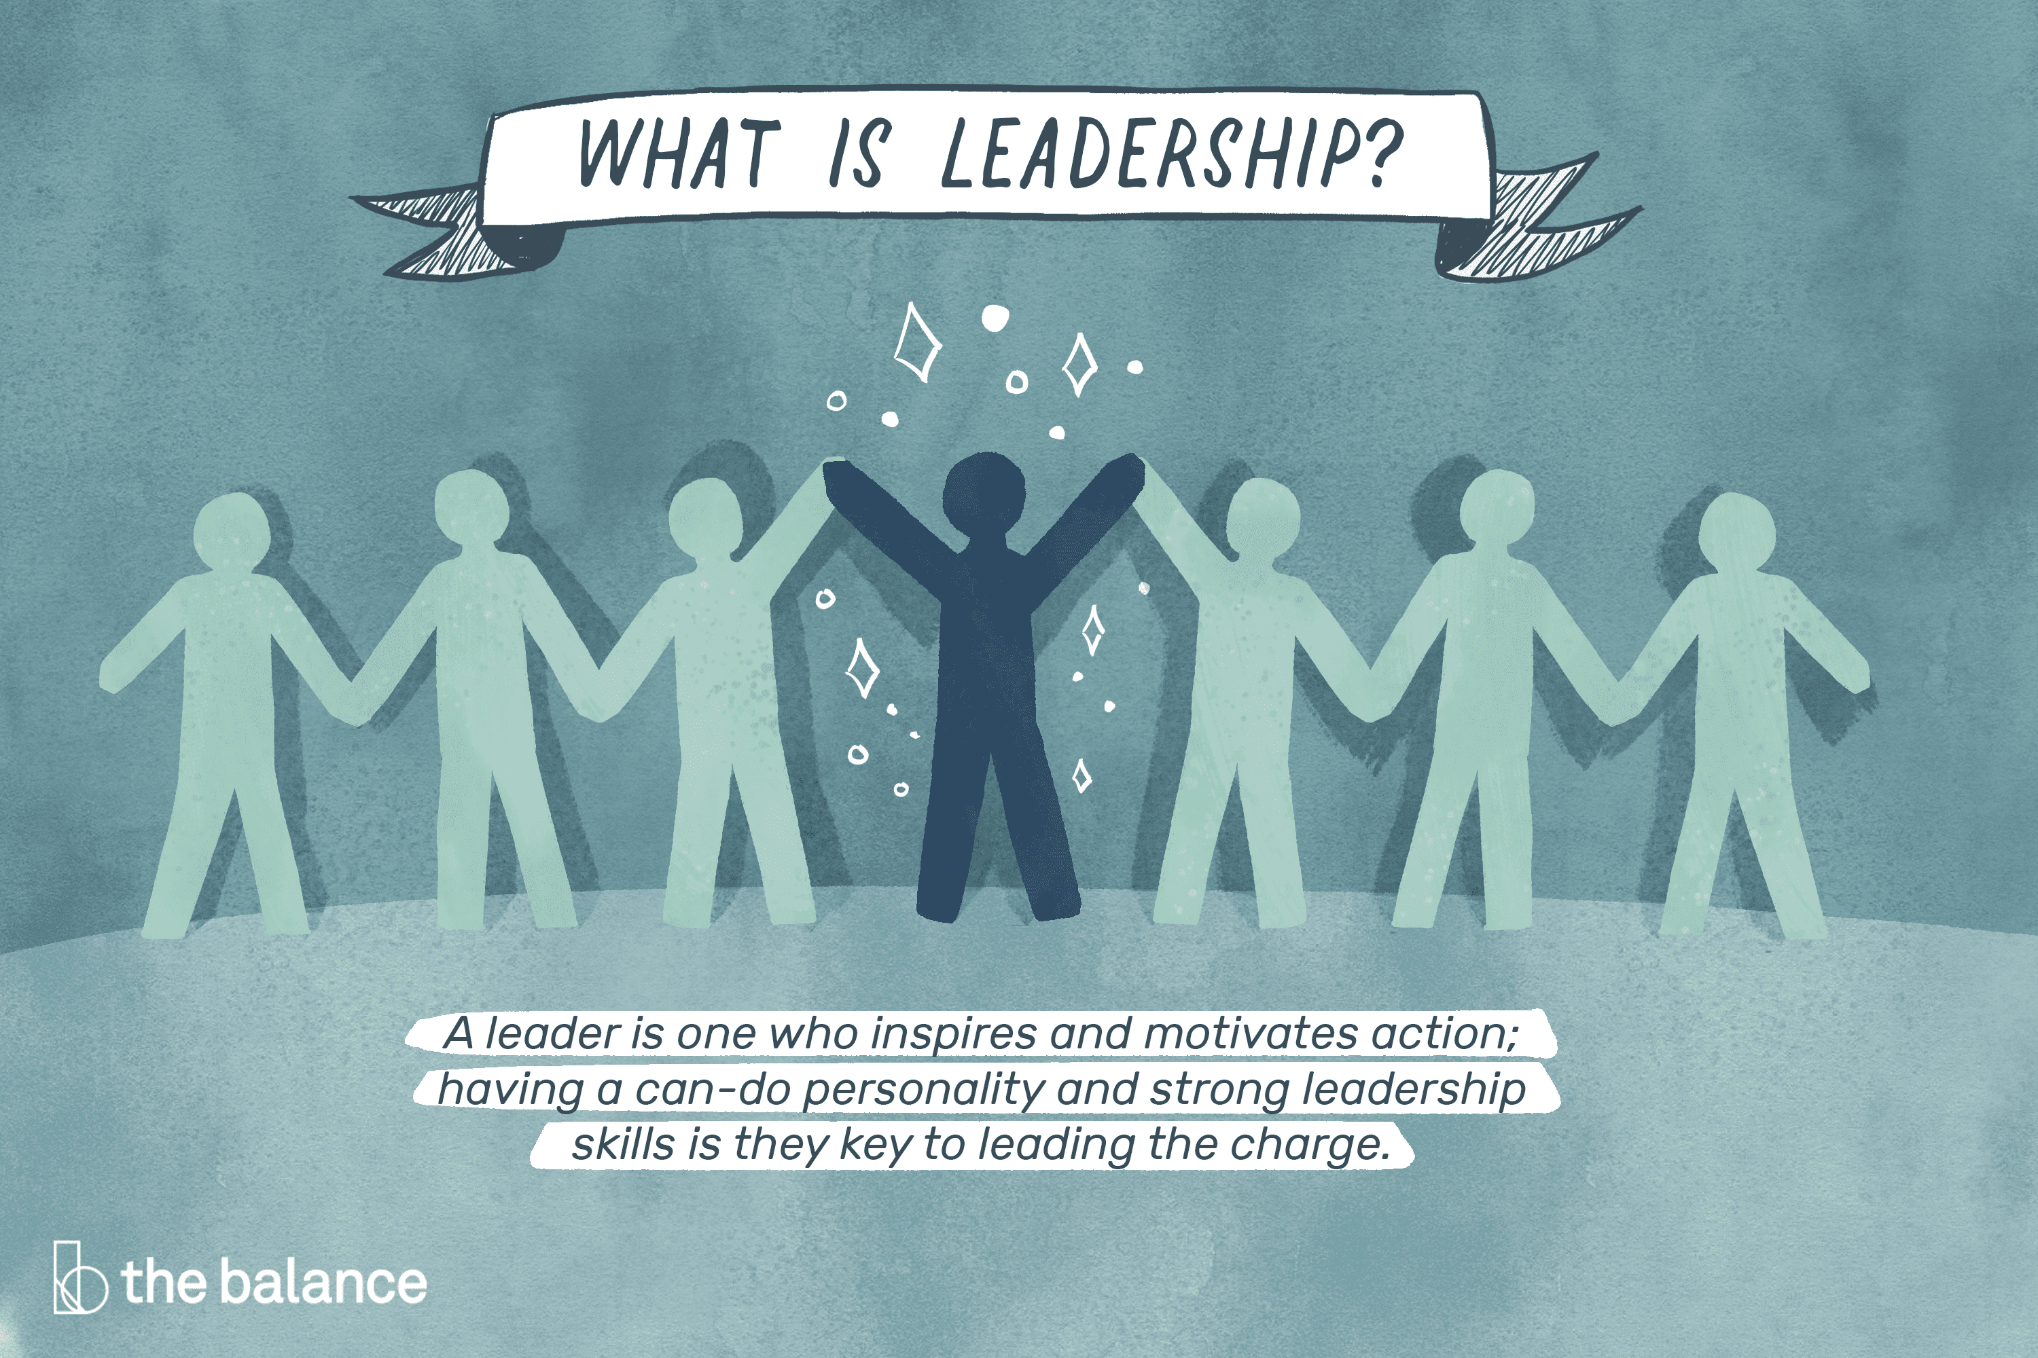
Concept
Leadership: The ability to influence a group toward the achievement of a vision or a set of goals

Slide 8

Need

Slide 9
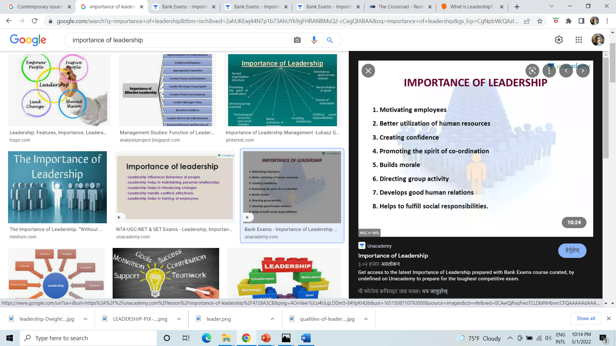
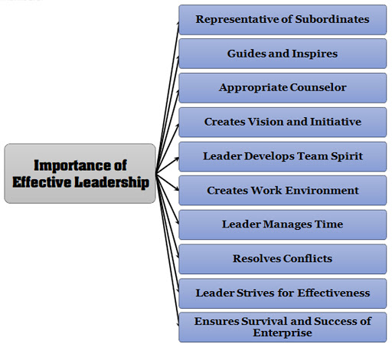

Slide 10
10 reasons why leadership is important in the workplace:
1. Improves Communication
One of the most important duties of a leader is to facilitate communication within the workplace. Clear and concise communication is essential for any team to function correctly. Effective leaders will make it a point to keep lines of communication open at all times and create an open and inclusive environment where everyone feels comfortable sharing their ideas. By ensuring employees have a forum to voice their concerns and opinions, a leader can encourage a work culture where new ideas are welcome, and misunderstandings are avoided.
2. Creates A Better Work Environment
Leaders have a profound impact on their overall work environment. Effective leaders create an atmosphere of trust and respect, which in turn fosters creativity and collaboration. Employee morale is also higher in workplaces with strong management, leading to stronger workplace relationships. When employees feel engaged with their team and that their contributions matter, they are more likely to be motivated to go above and beyond in the workplace.
3. Improves Productivity
A successful leader makes all the difference in a team’s productivity. When employees feel excited about the work they’re doing, they are more likely to be productive. On the other hand, a poor leader can cause employees to become disengaged and uninterested in their work. A team that is led effectively will be more productive, efficient, and successful overall.

Slide 11
4. Increases Efficiency
A productive leader can help to improve efficiency by getting the most out of their team. Leaders can help improve efficiency by ensuring everyone is working towards the same goal and doing what they do best. They can provide guidance and direction while delegating tasks to make the most of everyone’s strengths.
5. Decreases Mistakes
A capable leader is essential for any workplace that wants to minimize mistakes and run smoothly. This is especially important in high-pressure environments where mistakes can have serious consequences. A leader needs to be able to identify potential problems early on and quickly resolve them.
6. Motivates Employees
Good leaders know how to effectively motivate their employees. They understand that people are different and that what works for one person may not work for another. As a result, they take the time to get to know their team members and discover what works best for them. This can then create a more motivated group of employees who are excited about their own strengths and workplace contributions.
7. Sets a Good Example For Others
An effective leader knows that setting a good example is one of the best ways to inspire others. After all, people are more likely to follow someone they see as a role model. By behaving in a way that exemplifies the values and goals of their team or organization, good leaders can show others what it means to be a committed and successful member.

Slide 12
8. Inspires Hard Work
A great leader can instill a sense of purpose in their team. When people feel like they are working towards something bigger than themselves, they are more likely to be willing to put in the hard work required to achieve it. An effective leader knows how to tap into this sense of purpose and channel it into productive effort.
9. Creates A Strong Vision And Direction For The Future
A successful leader understands the importance of having a solid vision and how to create one that will guide their organization toward a bright future. Without a clear vision, maintaining momentum or progressing toward long-term goals can be challenging. A leader with a strong vision can create a sense of direction and purpose, helping to focus and energize an entire organization.
10. Helps Keep Employees On Track
Once the company’s vision is well-articulated and understood, sound leadership is essential to keep employees focused on reaching that goal. This means clearly communicating the company’s vision and objectives as progress is made and changes occur, and then providing the necessary support and resources for success.

Slide 13
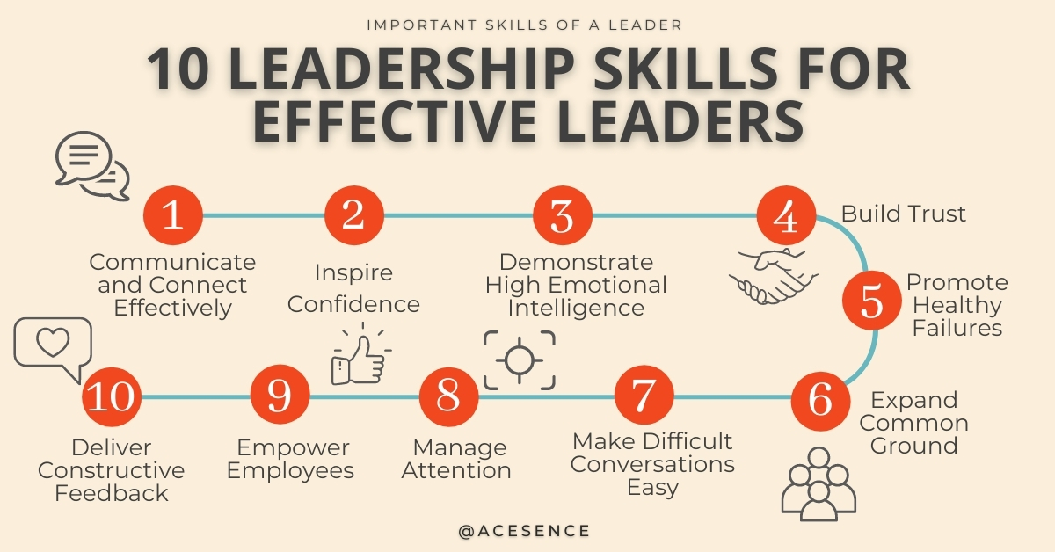
Notes:
https://blog.acesence.com/10-important-leadership-skills-for-effective-leaders/

Slide 14
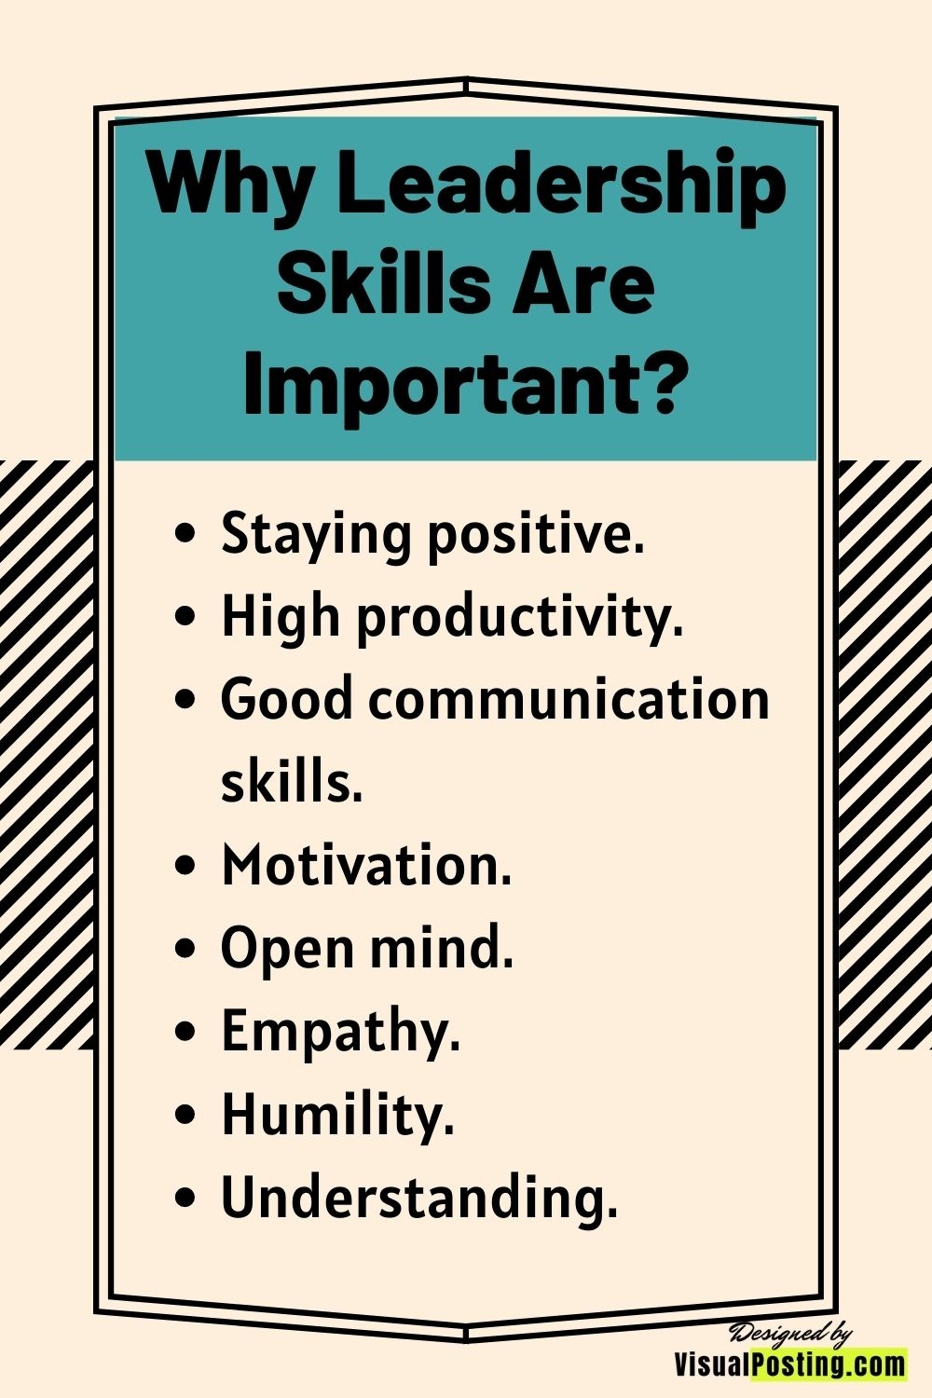
What is humility in leadership?
In leadership, humility is defined as the ability to remain aware of yourself, appreciate other people's strengths and contributions, and openness to new ideas and feedback regarding your performances. A humble leader can improve the rate of employee engagement, which leads to better job satisfaction rates.
Notes:
What is humility in leadership?
In leadership, humility is defined as the ability to remain aware of yourself, appreciate other people's strengths and contributions, and openness to new ideas and feedback regarding your performances. A humble leader can improve the rate of employee engagement, which leads to better job satisfaction rates.

Slide 15
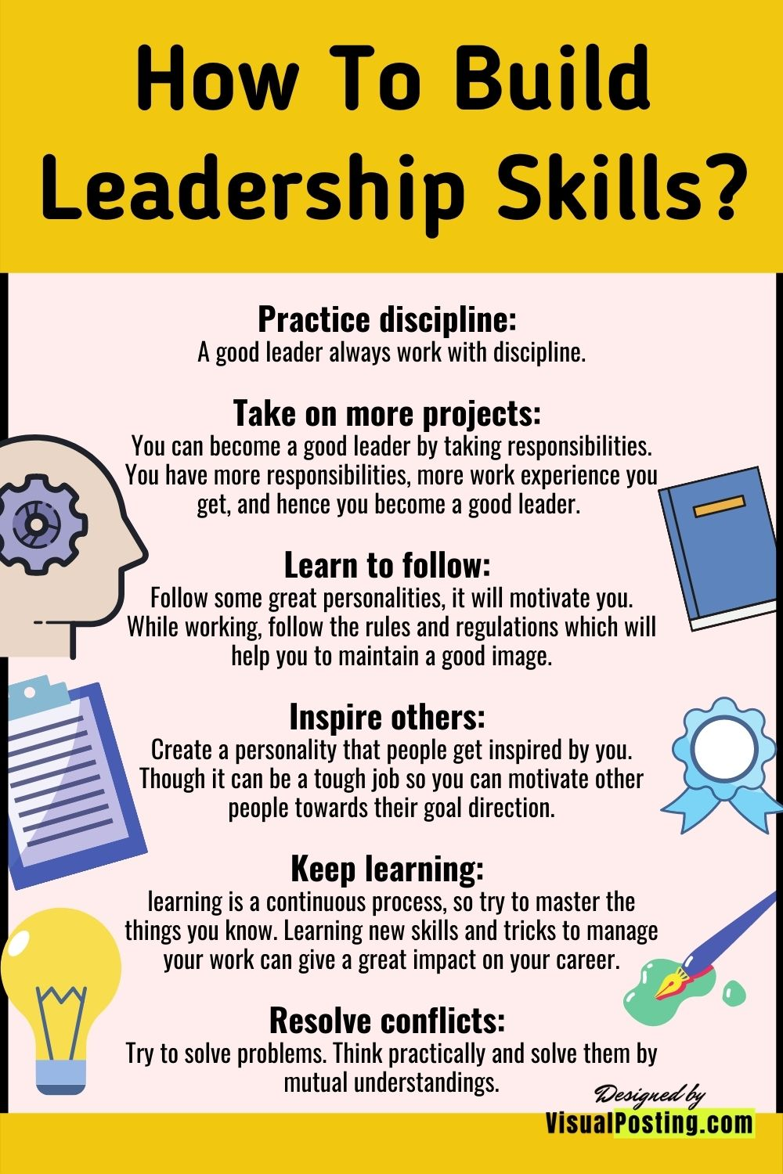

Slide 16
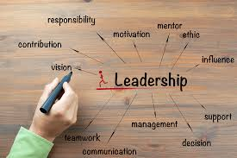
Why

Slide 17
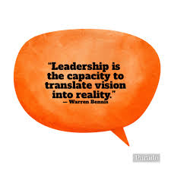
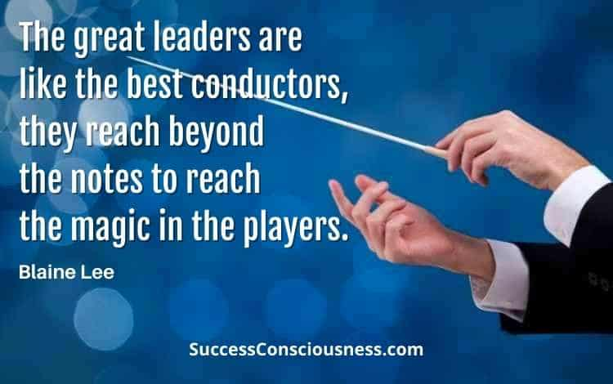
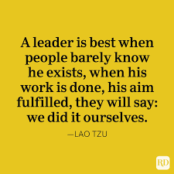
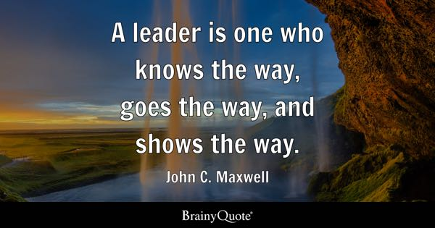
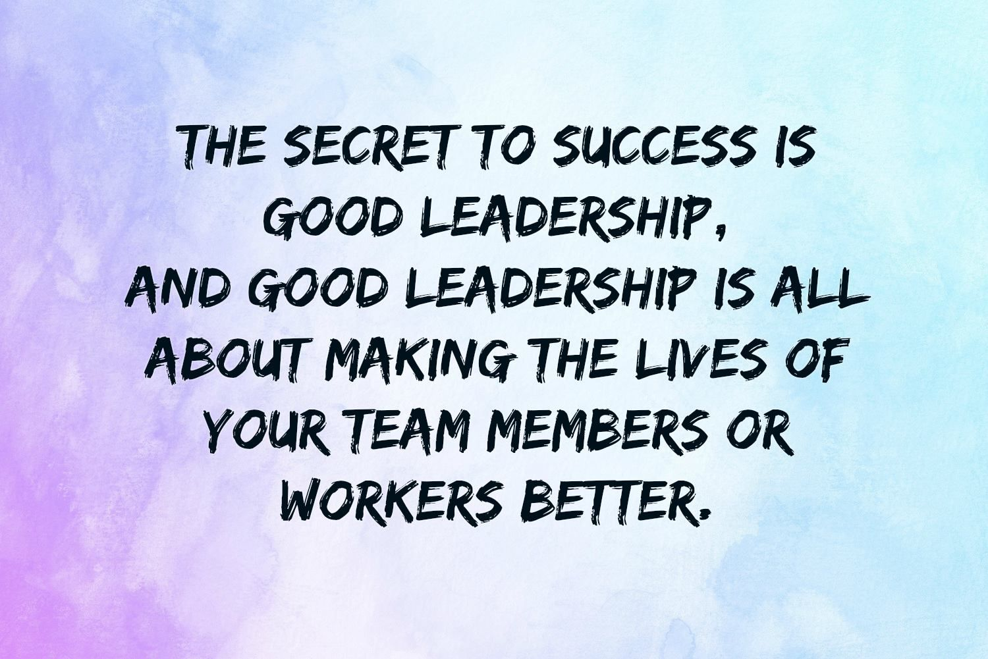
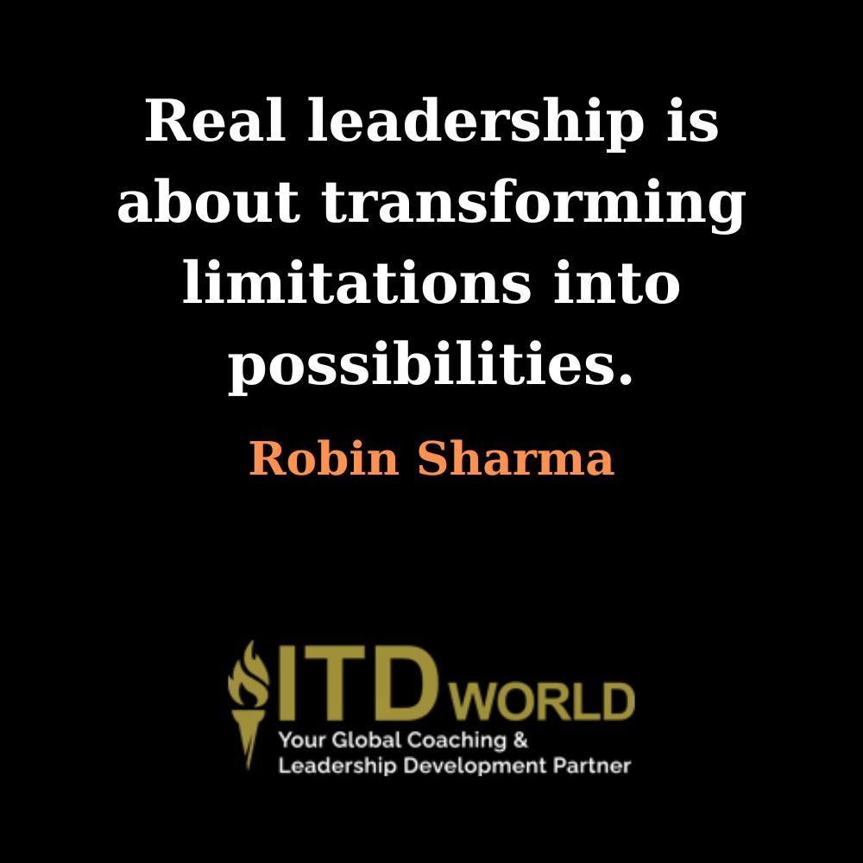

Slide 18
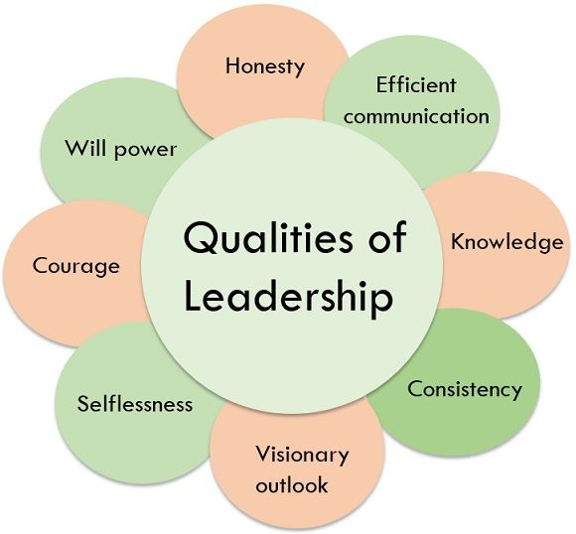

Slide 19
Selflessness: The base and the heart of leadership quality is selflessness. The leader should set his objectives without being selfish and self-centric. The other two elements that a leader should have along with selflessness are character and knowledge. Leaders, by the energy of their character, get the job done by managing people suitably. And on the ground of their knowledge, decides what to do in any circumstances.
Courage: The most astonishing human quality that a leader must retain is the courage to face the situations and take responsibility for success and failure of the decision taken by him or by his/her team members. A good leader is the one who has the courage to take responsibility for failure but gives credit to his/her team when succeeds.
Will power: Will power is a quality which is uniformly required in all prominent leaders. Thousands of difficulties emerge, and failures took place while executing plans. A good leader should have strong willpower to face hurdles instead of getting disappointed with failures while implementing the plans. The strong will power of a leader boosts his/her teammates will power and encourages them to give their best.
Efficient communication: Good communication is the key to become an admirable leader. The logic behind it is clear if the leader carries all types of leadership qualities, yet if he fails to communicate properly, he will never be an admirable leader.

Slide 20
Knowledge: Leaders learn by way of their exertions which build up their knowledge. They intensify their experience by working in the department of work which can’t be interchanged by any device. A leader is also enforced to have a knowledge of handling people; although, appropriate knowledge of job also strengthens the confidence level of the leaders.
Honesty and Integrity: Honesty and integrity are the priceless assets of a leader and treated as the most commendable attribute of a leader. The leader should be honest with both his employees and the management of the organization. A leader should always keep their integrity above all else as once it ruins; it gets lost forever.
Consistency: Leadership effectiveness without consistency is illogical. The path of every leader is rare to oneself. Consistency helps in attaining a leadership position; however, it is not the only approach for effective leadership; it works along with other aspects of good leadership quality. A good leader can correct the rough spots but never let their team confuse by displaying inconsistency in his/her decisions.
Visionary outlook: It is one of the unique traits of the leader. They must be competent to look further where the company is standing today, recognize where the business is moving, and use that perspective to run the company ahead.

Slide 21
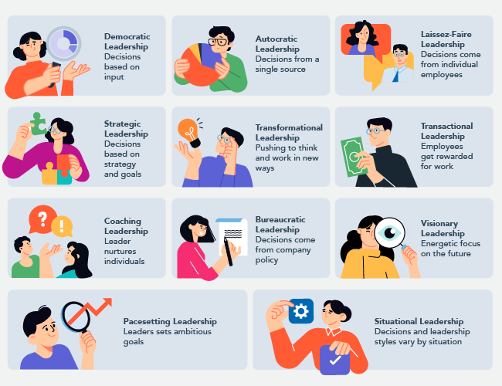
Styles of Leadership

Slide 22
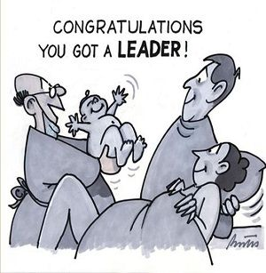
Theory of Leadership
Trait theory
The trait theory of leadership suggests that certain inborn or innate qualities and characteristics make someone a leader. These qualities might be personality factors, physical factors, intelligence factors, and so on.
Basic assumption of trait approach
By birth leaders receive leadership traits.
Leadership success is largely a matter of personality, a function of specific traits
They differ from their followers
Traits remain unchanged across time.
Notes:
The trait theory of leadership looks at personality, social, physical, or intellectual traits that differentiate leaders from non-leaders. Initially this theory was based on studies that looked at over 80 different traits, which allowed almost anything to be defined as leadership. A breakthrough occurred when researchers began to organize the traits into categories, and this became known as the Big Five Personality Framework where five groups of traits were found to be consistently present among leaders.
Some essential leadership traits include extraversion, conscientiousness, openness , agreeableness, and emotional intelligence (EI), although the link between EI and leadership has not been fully explored.
With the many years of research dedicated to the trait theory of leadership, it is widely accepted that traits do predict leadership. However, it is more likely that they predict the emergence of a leader rather than the effectiveness of a leader.

Slide 23
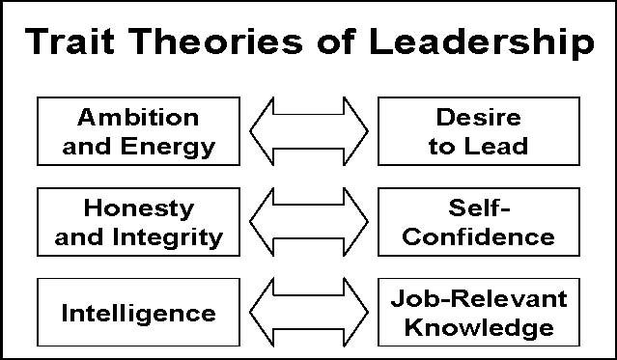

Slide 24
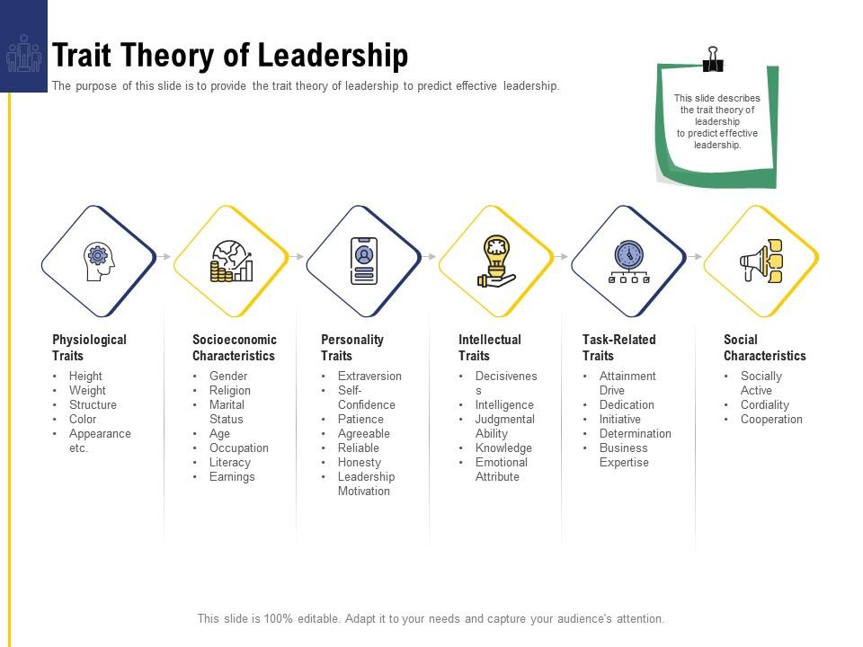

Slide 25
Behavioral Theory
The behavioral leadership theory focuses on how leaders behave, and assumes that these traits can be copied by other leaders. Sometimes called the style theory, it suggests that leaders aren't born successful, but can be created based on learnable behavior.

Slide 26
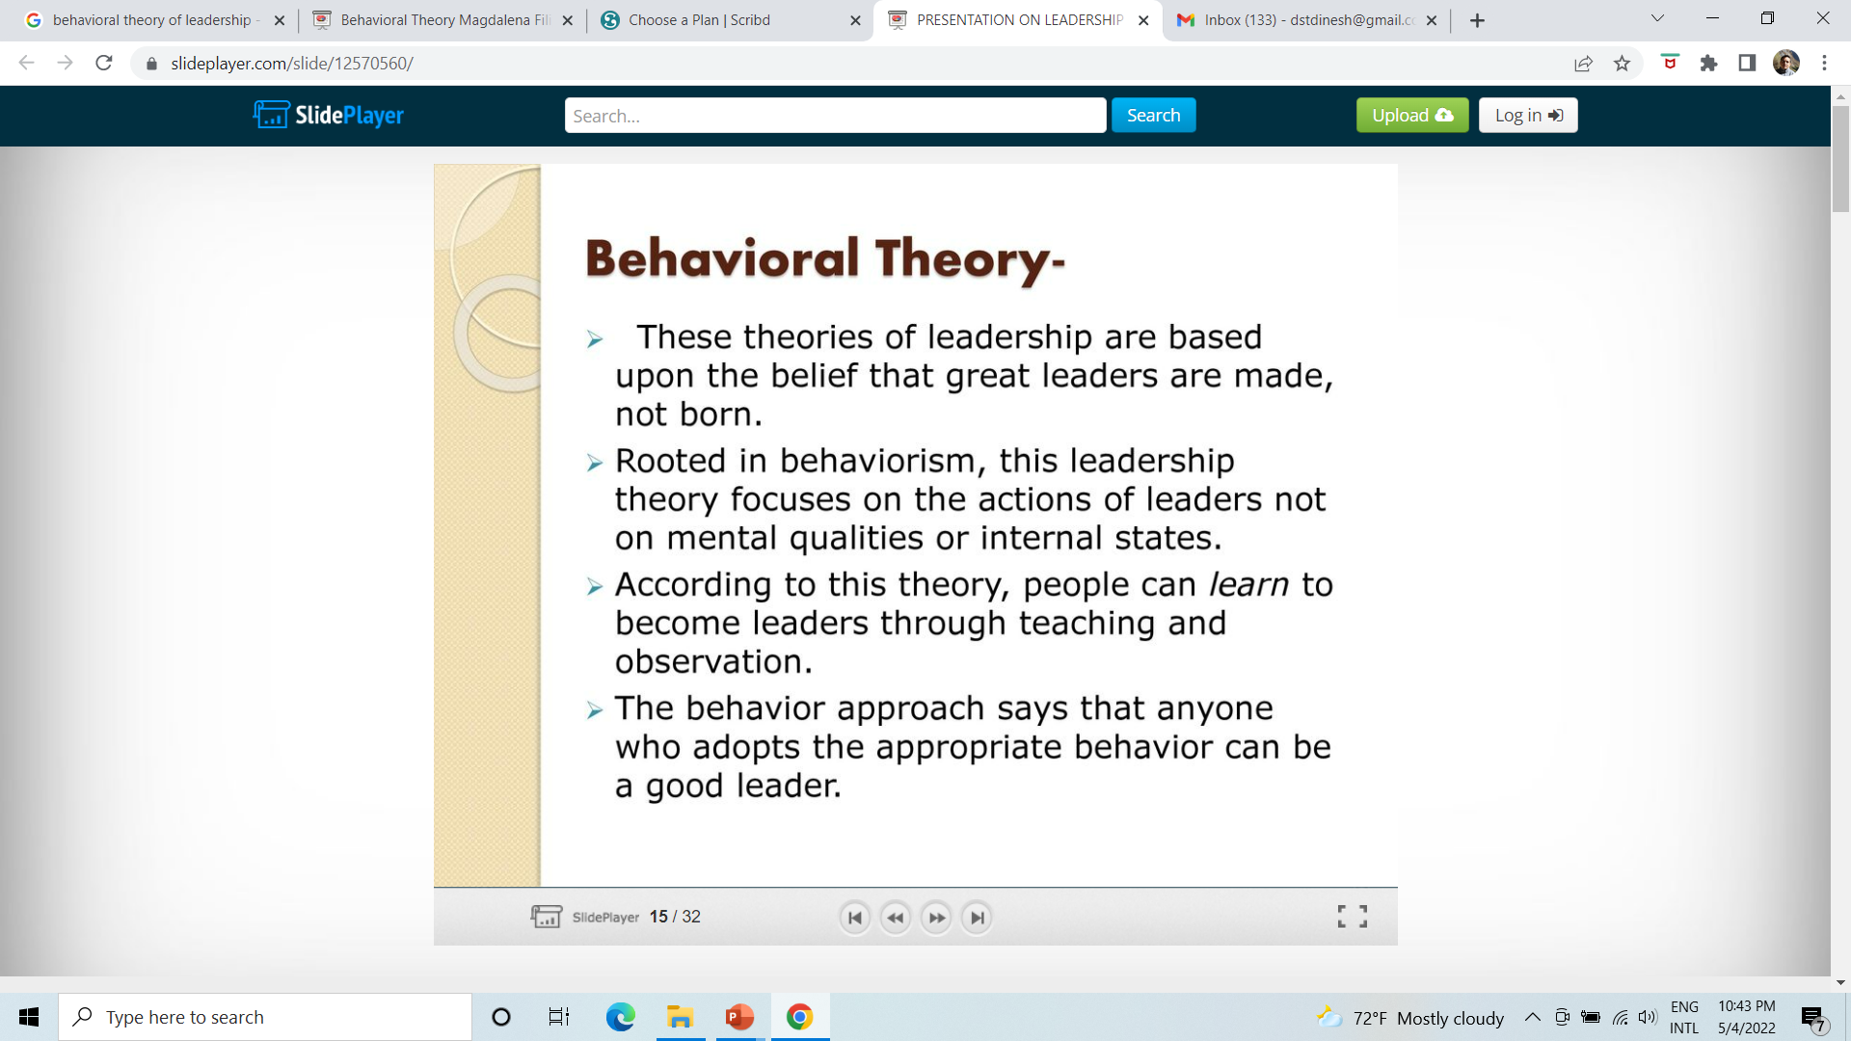

Slide 27
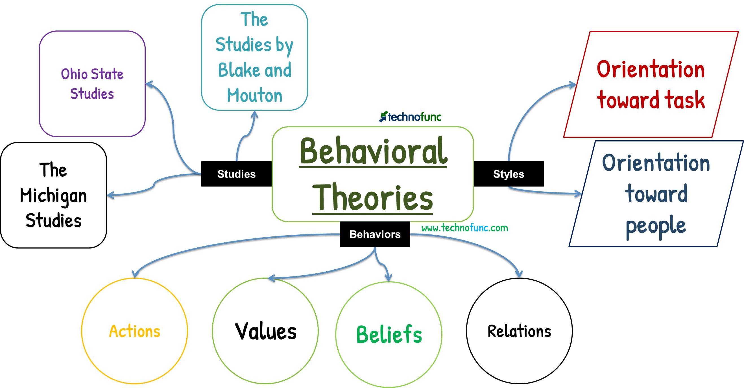

Slide 28
Leadership theories based on behavioral theory are:
Ohio State Studies
University of Michigan Studies
The Managerial Grid
(Leadership Grid or Hi-Hi Leadership)

Slide 29
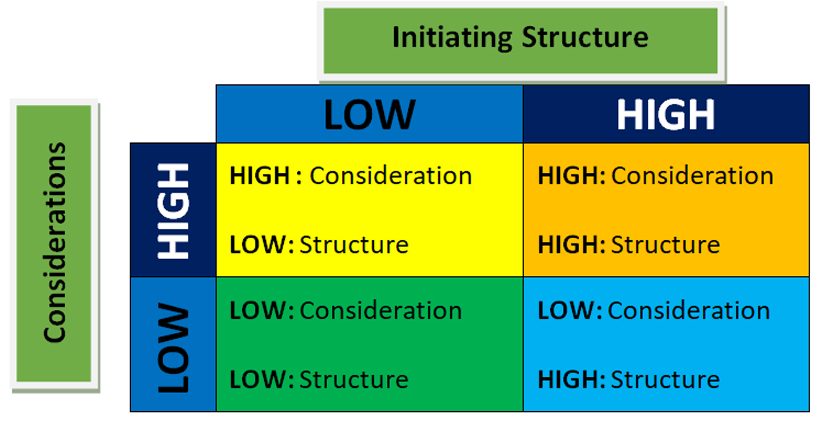
Ohio State Studies
In 1945, a group of researchers at Ohio State University began extensive investigations of leadership. They described consideration behavior is people oriented leadership dimension where leaders are sensitive to make people happy at work. They also try to provide pleasant work environment and are highly employee-centered. Similarly, the central focus of their work was to study in depth the work of a leader. Their effort uncovered many things concerning leadership behavior. The most publicized aspect of Ohio state leadership was the isolation of two dimensions of leadership behavior. Initiating structure: A high initiating structure score indicates that leaders structures their role those of subordinates towards the attainment of goals. They are actively involved in planning work activities, communicating pertinent information and scheduling work.
Consideration: A leaders who were high on the consideration dimension reflected that they had developed a work atmosphere of mutual trust, respect for subordinate’s ideas and consideration of subordinate’s feelings. Such leaders encouraged good superior subordinate rapport and two-way communication. A low consideration score indicates that leaders are more impersonal in their dealing with subordinates.

Slide 30
University of Michigan Studies
A team of researchers at the University of Michigan undertook the research in the late 1940s. In these studies, they have tried to find leader's behavior. Researchers have undertaken a few studies among low and high performing groups in different organizations. Upon the completion of the research, they categorized leadership behaviors into two headings: employee-centered and production-centered. Whereas employee-centered leaders or supervisors are more employee welfare oriented, production-centered leader are more concerned with getting works done. According to these studies, employee centered leaders emphasize on human relations in organization. They believe that such behaviors are very productive at the workplace.
The study also showed that Employee-oriented Leaders (EOL) were associated with higher group productivity and higher job satisfaction on the other hand, Production-Oriented Leader (POL) tends to be associated with low group productivity and lower job satisfaction. Where, we mean Employee-oriented leaders (EOL) – One who emphasizes interpersonal relation. Production-oriented leaders (POL) – One who emphasizes technical or task aspects of the job.

Slide 31
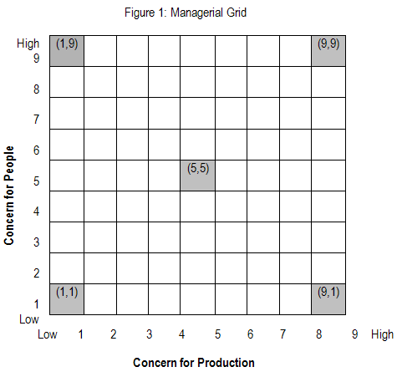
The Managerial Grid (Leadership Grid or Hi-Hi Leadership)
The concept of managerial grid was created by R.R. Blake and Jane S. Mouton of USA. They emphasize that leadership style consists of facts of both task oriented and relation oriented behavior in varying degrees. They have used two behavioral dimensions:
Concern for production means the attitudes of the supervisors towards a variety of factor concerning production, such as product, procedures and processes, quality of staff service, workload, efficiency and quantity of production.
Concern for people includes degree of personal commitment towards goal achievement, maintaining the self-esteem of workers, responsibility and conductibility based on trust rather than on force and satisfying interpersonal relations.
1.1 management (impoverished Style) : very little concern for people or production.
9.9 management (team builder style) : high concern for both people and production.
5.5 management (middle of the roader style) : balanced concern for people and production
1.9 management (country club style) : very high concern for people and
low concern for production
9.1 management (task manager) very high concern for production and
low concern for people

Slide 32
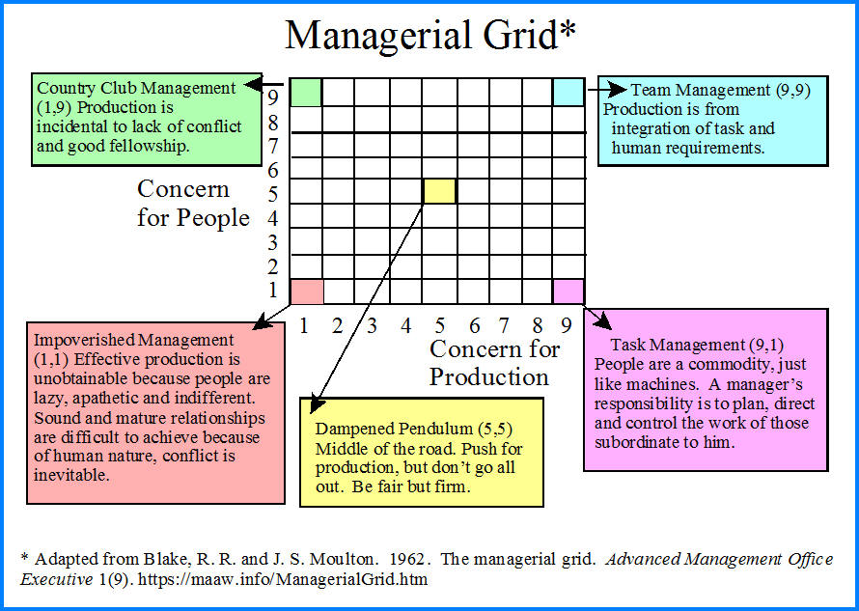

Slide 33
Transactional theory
Transactional theory, particularly in the context of literature and reading, posits that meaning is not inherent in the text itself but is actively constructed during the interaction between the reader and the text. This theory, developed by Louise Rosenblatt, emphasizes the reader's unique experiences, background, and emotional responses as crucial elements in shaping meaning.

Slide 34
Transactional Theory
Transactional leadership involves motivating and directing followers primarily through appealing to their own self-interest. The power of transactional leaders comes from their formal authority and responsibility in the organization. The main goal of the follower is to obey the instructions of the leader. The style can also be mentioned as a ‘telling style’.
The leader believes in motivating through a system of rewards and punishment. If a subordinate does what is desired, a reward will follow, and if he does not go as per the wishes of the leader, a punishment will follow. Here, the exchange between leader and follower takes place to achieve routine performance goals.

Slide 35
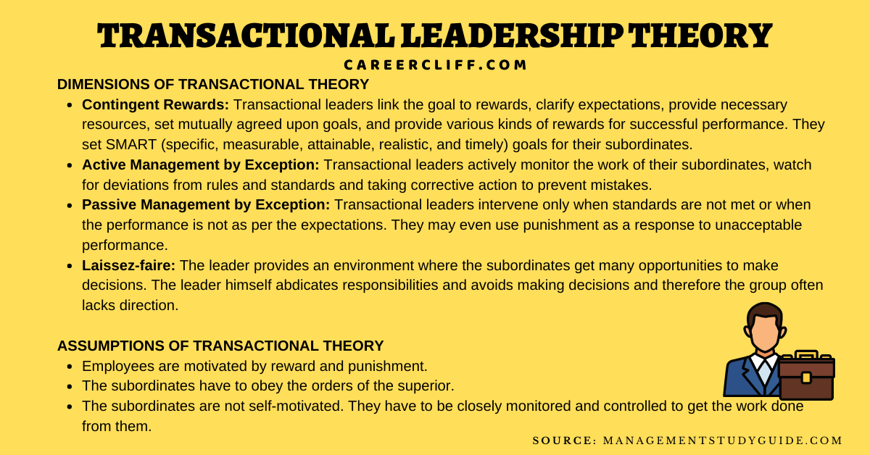

Slide 36
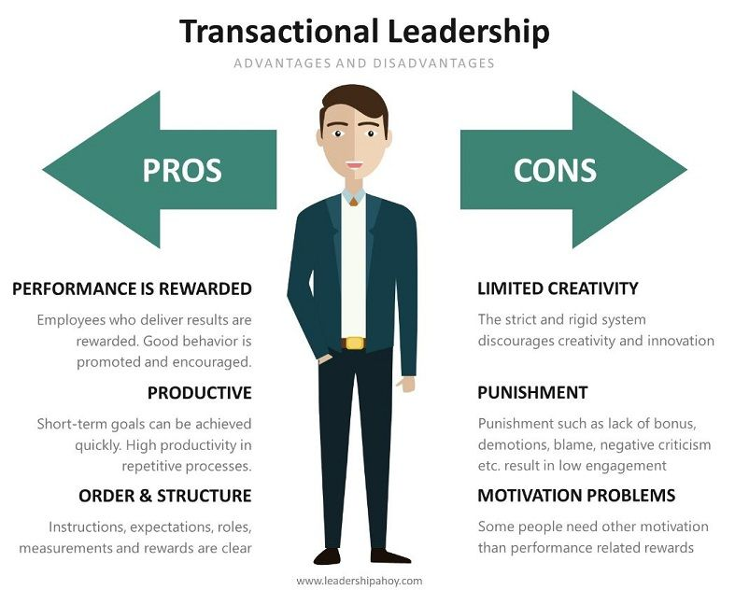

Slide 37
Transformational theory
Transformational theory encompasses two main areas: Transformational Leadership and Transformational Music Theory. Transformational Leadership, developed by Burns and Bass, focuses on inspiring and motivating followers to achieve exceptional results and embrace long-term goals. Transformational Music Theory, pioneered by David Lewin, provides a framework for analyzing musical transformations using mathematical principles.
Transformational leadership theory promotes a style of guidance that emphasizes motivating employees, and creating a vision and encouraging them to fulfill it. The fundamental skills of a transformational leader include being able to mobilize employees, inspire them and boost their morale.

Slide 38
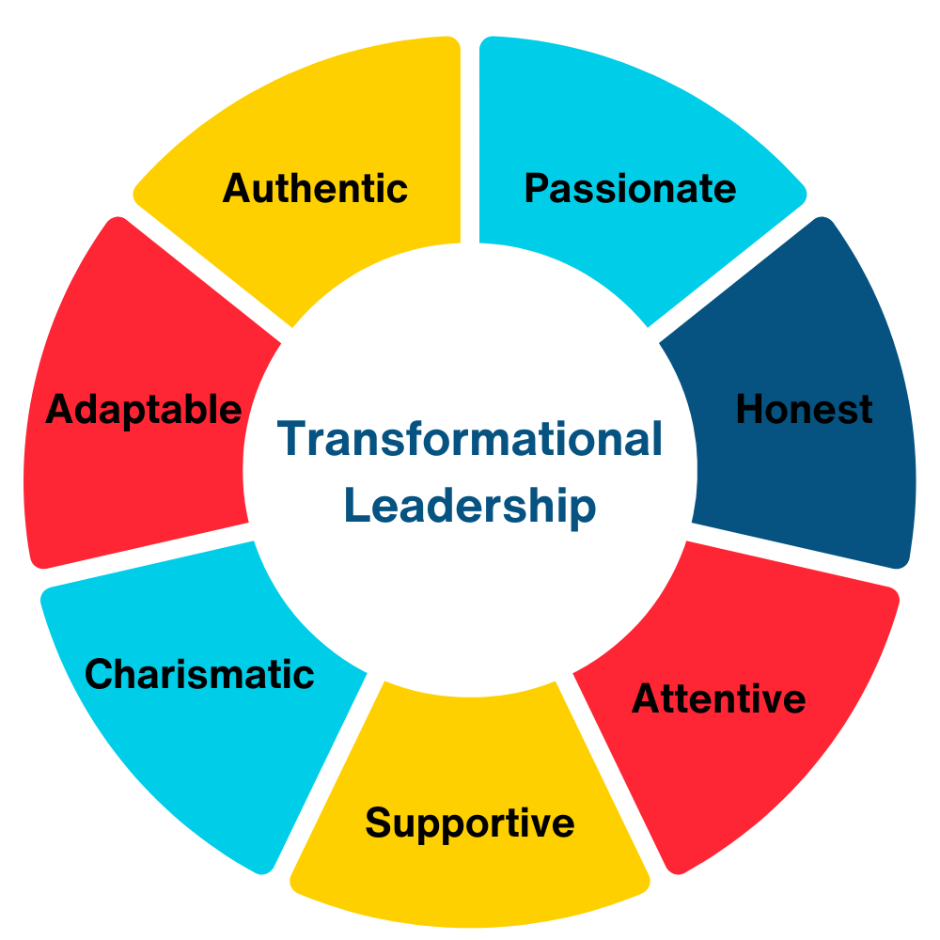
Transformational Theory
Transformational leadership is a leadership style that can inspire positive changes in those who follow. Transformational leaders are generally energetic, enthusiastic, and passionate. Not only are these leaders concerned and involved in the process; they are also focused on helping every member of the group succeed as well.

Slide 39
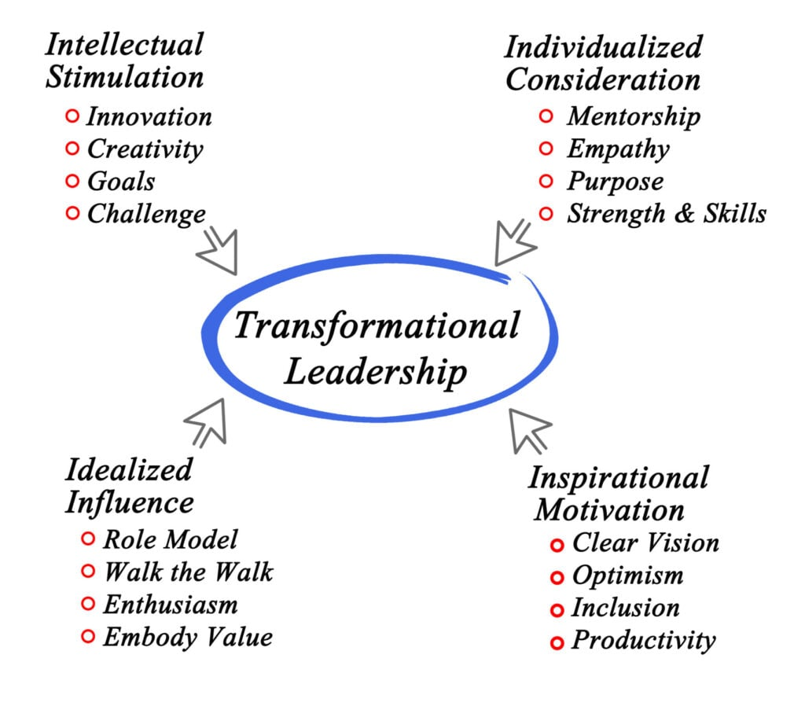
There are four factors to transformational leadership, (also known as the "four I's"): idealized influence, inspirational motivation, intellectual stimulation, and individual consideration. Each factor will be discussed to help managers use this approach in the workplace.

Slide 40
Here are some characteristics of transformational leaders:
Inspiring: They can inspire followers to change their perspectives and work toward shared goals
Open-minded: They're willing to identify and change outdated business processes
Empowering: They trust employees to make decisions and solve problems
Authentic: They set an example for their employees
Risk-taking: They make calculated decisions based on their experience, instincts, and intelligence from their team

Slide 41
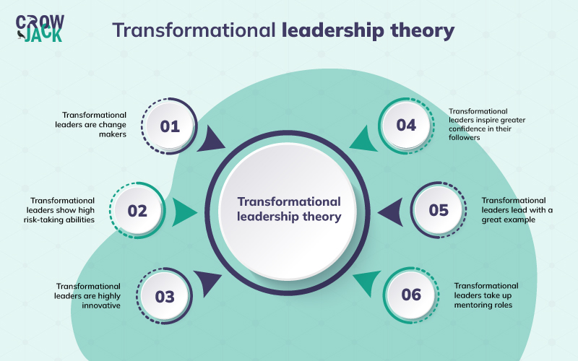
Key features of Transformational Leadership Theory

Slide 42
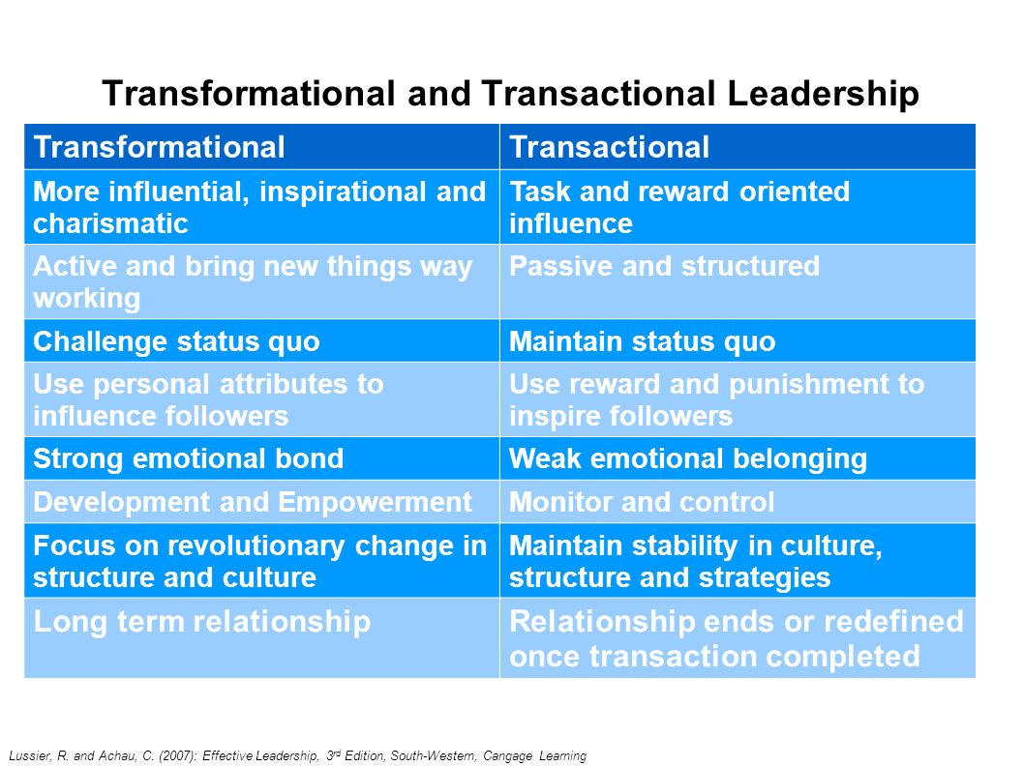

Slide 43
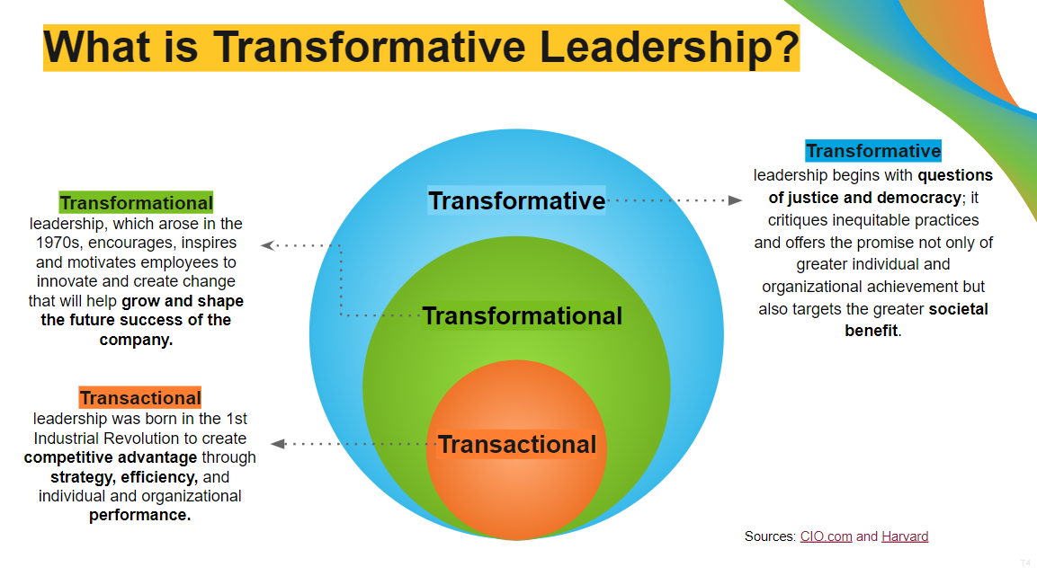

Slide 44
Charismatic leadership
Charismatic leadership is defined by a leader who uses his or her communication skills, persuasiveness, and charm to influence others. Charismatic leaders, given their ability to connect with people on a deep level, are especially valuable within organizations that are facing a crisis or are struggling to move forward.

Slide 45
Charismatic Leadership focuses on the leaders themselves. It’s the ability to communicate, influence, and be comfortable in their own skin. Charisma is a process, a quality that requires transforming visions into a reality. And this is precisely what you must follow as a leader or a manager.
It is further defined by leaders who use their powerful personality and excellent communication skills to persuade employees and keep them engaged during crises. If you are a charismatic leader, you will help your organization move forward while it is struggling to progress.

Slide 46
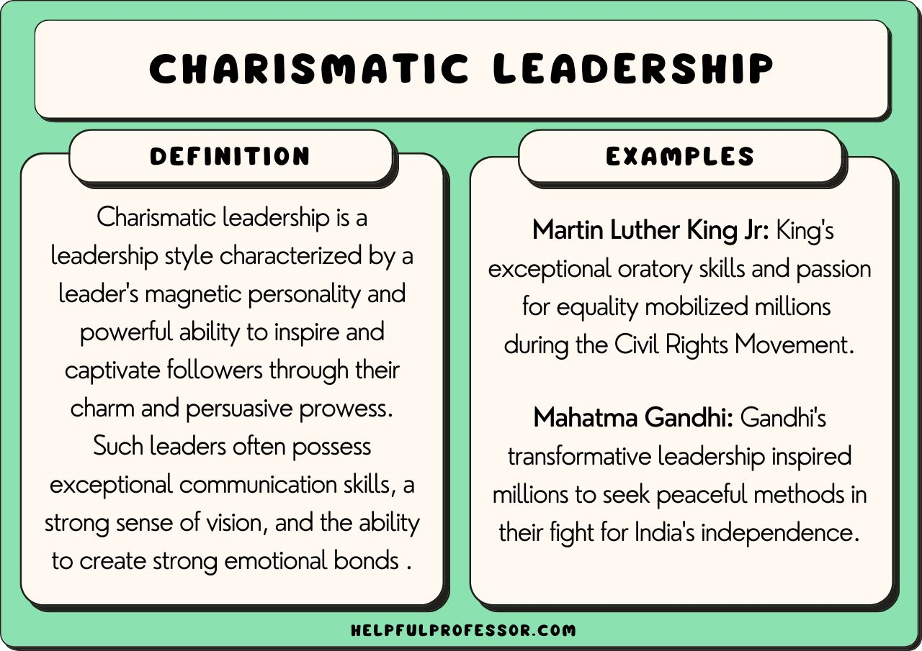

Slide 47
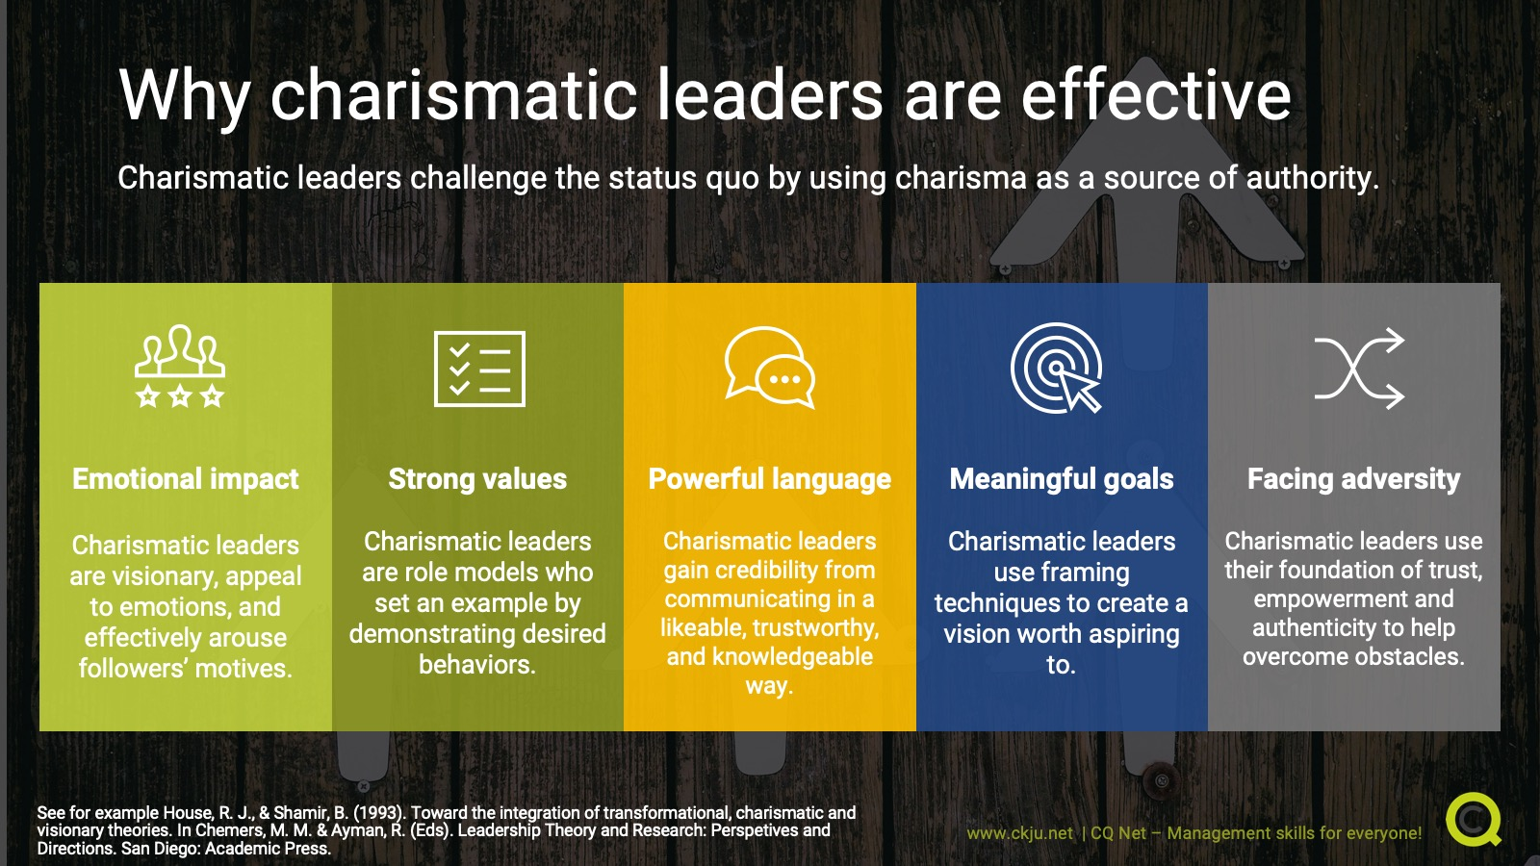

Slide 48


Slide 49
Pros:
Charismatic leaders motivate and inspire the workforce.
Encourages the importance of friendly, collaboration, and teamwork
It involves good listening skills; hence employee queries do not go unheard.
Creates a sense of positive change.
Cons:
Charismatic leaders might display narcissism and shift the focus from their people to themselves.
Leaders might become self-serving.
It is often viewed as shallow or disingenuous (untrustful).

Slide 50
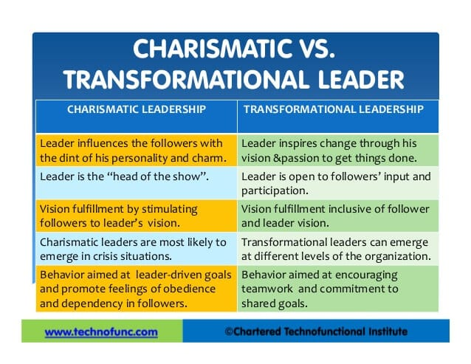

Slide 51
https://art-of-charisma.com/charismatic-leaders-today/

Slide 52
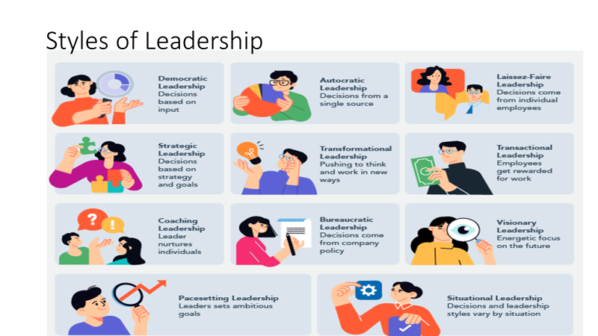

Slide 53
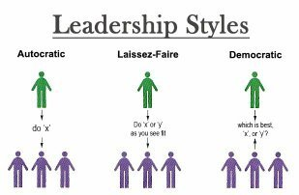
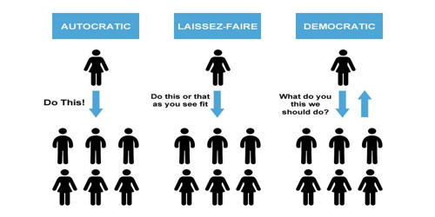

Slide 54
Leadership Styles
In 1939, Kurt Lewin identified three types of leadership styles in business: autocratic, democratic, and laissez-faire. Each, of course, comes with its own advantages and disadvantages.
Autocratic Style : A leader who is work or self centered is called autocratic style. He centralized power and decision making in him and exercises complete control over the subordinates.
Democratic Style : in this style leader gives equal focus to both work and people. He invites subordinates in decision making-decentralized authority. This style produces more job satisfaction and moral of employee.
Free rein (laisez faire) Style : just opposite to Autocratic Style is Free rein style. Such a leader is just like “full constitutional monarchy”. He does not lead but leaves the group entirely to itself. It is a kind of style where the leader gives employee complete freedom to make decision on work methods.

Slide 55
The autocratic business leader
The autocratic leader understands the strength of authority. Autocratic leaders are not interested in opening up the decision-making process to the entire group. Instead, they choose to bear the leadership completely alone. They expect those who fall under their authority to follow orders.
Advantages of an autocratic business leader
The main advantage of an autocratic leader is streamlined work that improves efficiency and productivity. They create firm deadlines and have a very clear set of expectations. This is ideal in a time of crisis or when last-minute decisions are needed. This leadership style allows for fewer misunderstandings as directions are passed down.
The disadvantages of an autocratic business leader
They often have a limited perspective. Given that they only draw from their own ideas and experience, any input from other members of the team will likely go unspoken. Those who work under this leadership style sometimes end up resenting their manager. They feel undervalued due to limited recognition of their contributions. Additionally, this leader is more likely to micromanage their team. Autocratic leaders tend to find themselves at the center of low work morale and high employee turnover.
When to use this style
The autocratic style is best used during a crisis when a leader is most valuable. You need someone who takes control to make quick and difficult decisions to potentially reduce damage. During times of emergency, teams appreciate a strong and decisive leader. Autocratic leadership may also come in handy when team correction is necessary. After the crisis has passed, it is generally beneficial to switch styles.

Slide 56
the democratic business leader
A democratic leader encourages the free exchange of ideas throughout the team. All members have a valued voice and the leader acts as a spokesperson or facilitator. Democratic leaders rely on the participation of every member of the group. They emphasize the value and expertise each member brings to the table. Every team member shares the freedoms and responsibilities of leadership.
Advantages of a democratic business leader
An advantage of democratic leadership is the boundless creativity of the entire group that allows for open discussion of issues and solutions. Team unity generally grows as a result of democratic leadership. This environment can make an employee feel appreciated, accomplished, and important to the success of the organization. Common office politics such as gossiping, cliques, and manipulation become much less prevalent. The end result is an improved work environment and lower employee turnover: 63% of employees who are recognized for their work are less likely to job hunt.
The disadvantages of a democratic business leader
Under democratic leadership, deliberation can be an unaffordable luxury. If decisions need to be made quickly, a democratic team may be unable to adapt and function under the stress. Democratic leadership can result in a lack of clarity around team members’ roles and responsibilities, and difficulty identifying employees who aren’t carrying their weight.
When to use this style
This is the most effective method for day-to-day work as it allows the group to take part in decision-making. This gives teams a feeling of ownership over projects, deliverables, and results. Many business leaders identify the democratic leadership style as their go-to style, but this technique can be less effective during times of crisis.

Slide 57
The laissez-faire business leader
Laissez-faire leaders are the hands-off type. They assign tasks and give general direction but they’re usually uninvolved in day-to-day tasks. Employees decide on the best approach to fulfill their responsibilities. Laissez-faire leaders put a great amount of faith in the individual. They trust them to remain self-motivated, on-task, and accountable. If issues arise, these leaders are available to offer direction, but only upon request. Laissez-faire leaders allow each member of their team to succeed or fail based on their own abilities.
Advantages of laissez-faire business leaders
An advantage of laissez-faire leadership is the freedom to operate without restrictions or interference from management. This gives skilled and self-motivated employees a chance to reach their fullest potential.
The disadvantages of laissez-faire business leaders
A disadvantage can be the loss of productivity without a strong leadership hand to keep it on track. This can result in missed deadlines, omissions in the process, and low-quality work. With each team member pursuing goals in their own way, team unity may suffer. Some may start to lose interest in work due to distant and seemingly uninterested leaders. This can lead to significant losses for the organization.
When to use this style
Laissez-faire leadership is best when individuals are able to function without supervision. Before using this style, make sure each team member has the right skill level and self-direction capability. They must be able to motivate themselves to keep the work going. Otherwise, this approach could backfire and cause more harm than good.

Slide 58
Management Styles
A management style is the methods and approaches a manager uses to achieve their goals. It can include how they plan, organize, make decisions, delegate tasks, and oversee their team.
Participative Management
Management By Objective
Management by exception

Slide 59
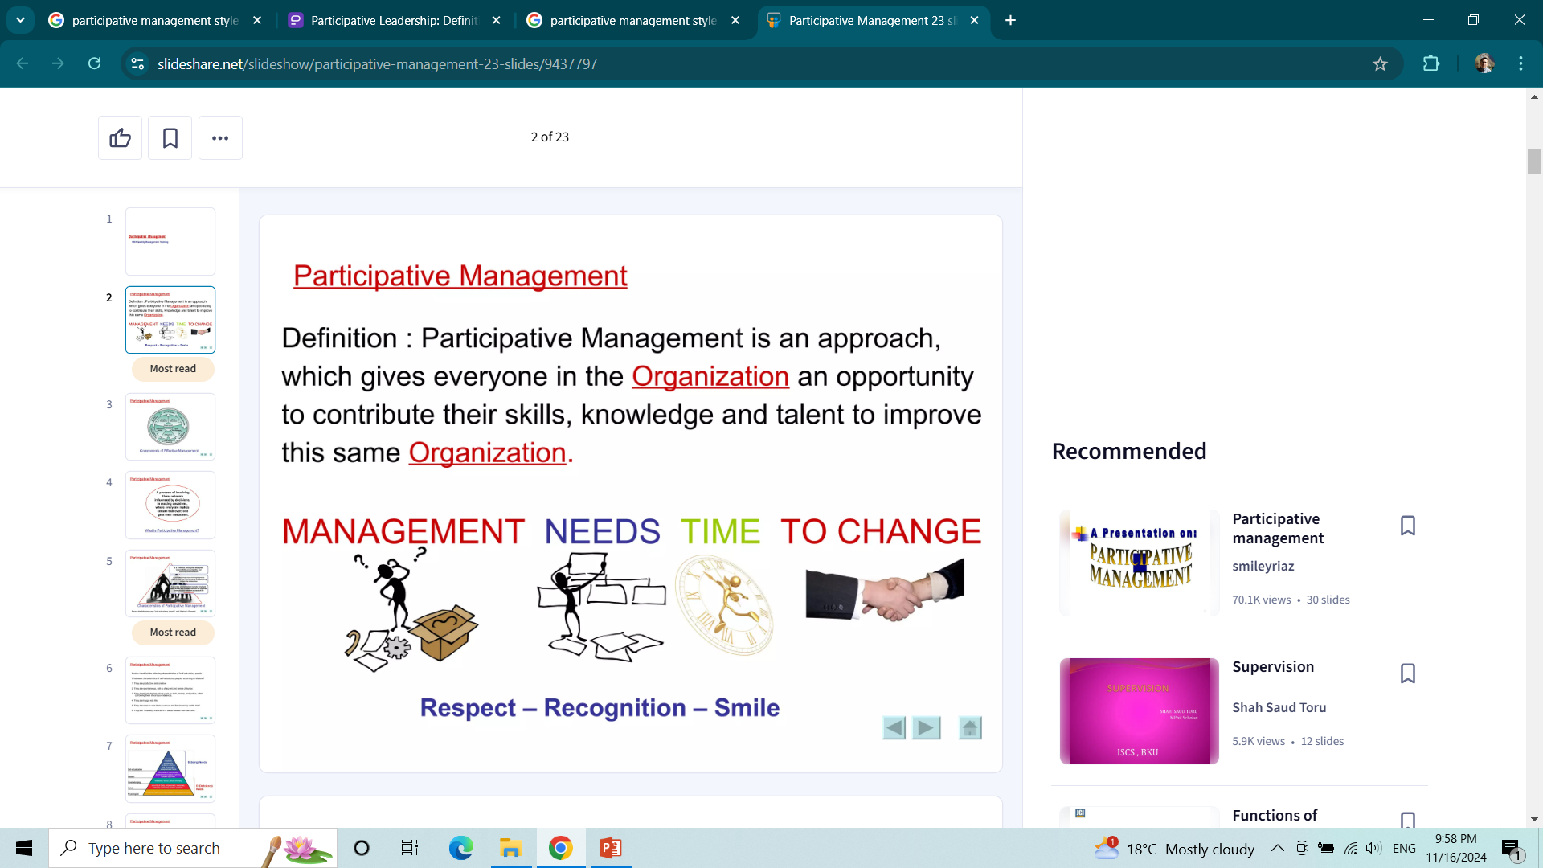
Participative Management

Slide 60
Participative Management
Participative Management refers to as an open form of management where employees are actively involved in organization's decision making process. The concept is applied by the managers who understand the importance to human intellect and seek a strong relationship with their employees.
That is why, it is also called as Participative Decision Making, Employee Involvement or Industrial Democracy. It comprises of various elements including increased communication and cooperation, joint decision making, quality circles, quality of work-life, increase in job satisfaction, conflict resolution, etc.

Slide 61
The importance of participative management is: The employees easily connect themselves with the organization, which results in improved performance. It motivates employees, due to their involvement in the management. It increases job satisfaction and cooperation of employees, which reduces conflicts in the workplace.

Slide 62
Objectives of Participative Management
Participative Management is a tool for increasing the productivity and efficiency of the organization, as well as building strong relations with the workers and employees. The objectives of Participative Management are:
To encourage harmonious relations between the company’s management and workmen.
To develop mutual trust and understanding amidst (within) the company’s management and workmen.
To give the opportunity to the workers to freely express their views towards the company’s goals and laws.
To attain a significant increase in production.
To provide welfare facility to the workmen.
To give training to the workers in understanding as well as sharing the responsibilities of the management.
To facilitate teamwork.
To develop a dynamic human resource.
To decrease labour turnover and absenteeism.

Slide 63
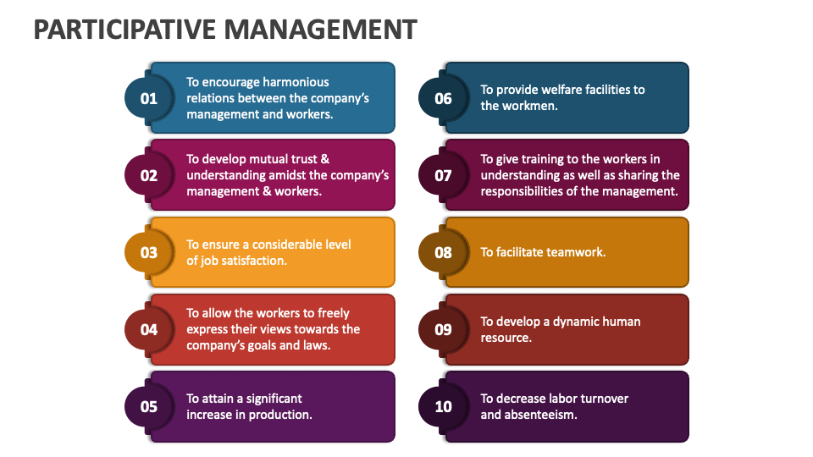

Slide 64
What are the advantages and disadvantages of participatory management for employees and the company?
Participatory management offers benefits to employees such as:
Satisfaction
Recognition
Personal development
Respect and motivation
They feel valued and involved in decision-making, which leads to an increase in productivity. However, it may encounter disadvantages such as:
The time and cost of implementation
Passive resistance of employees
Challenging the traditional hierarchy
Mismatch between employees in the event of a crisis
A good implementation of the concept requires expertise and careful management to avoid risks.

Slide 65
Management by objectives (MBO)
Management by objectives (MBO) is a strategic management model that aims to improve organizational performance by clearly defining objectives that are agreed to by both management and employees.
It refers to the process of setting goals for the employees so that they know what they are supposed to do at the workplace.
Management by Objectives defines roles and responsibilities for the employees and help them chalk out their future course of action in the organization.
Management by objectives guides the employees to deliver their level best and achieve the targets within the stipulated time frame.
Notes:
https://www.youtube.com/watch?v=K57rvR2nGu0&ab_channel=Educationleaves

Slide 66
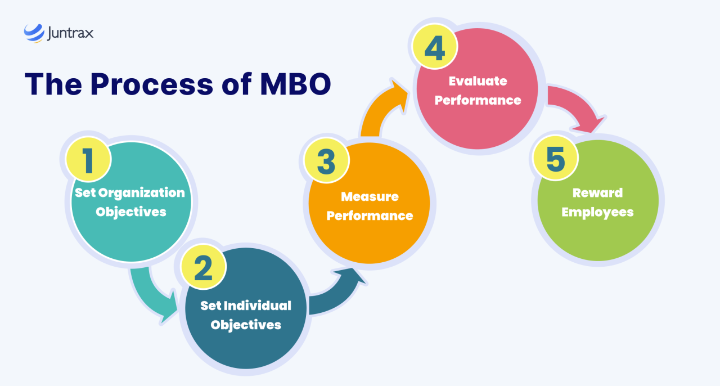
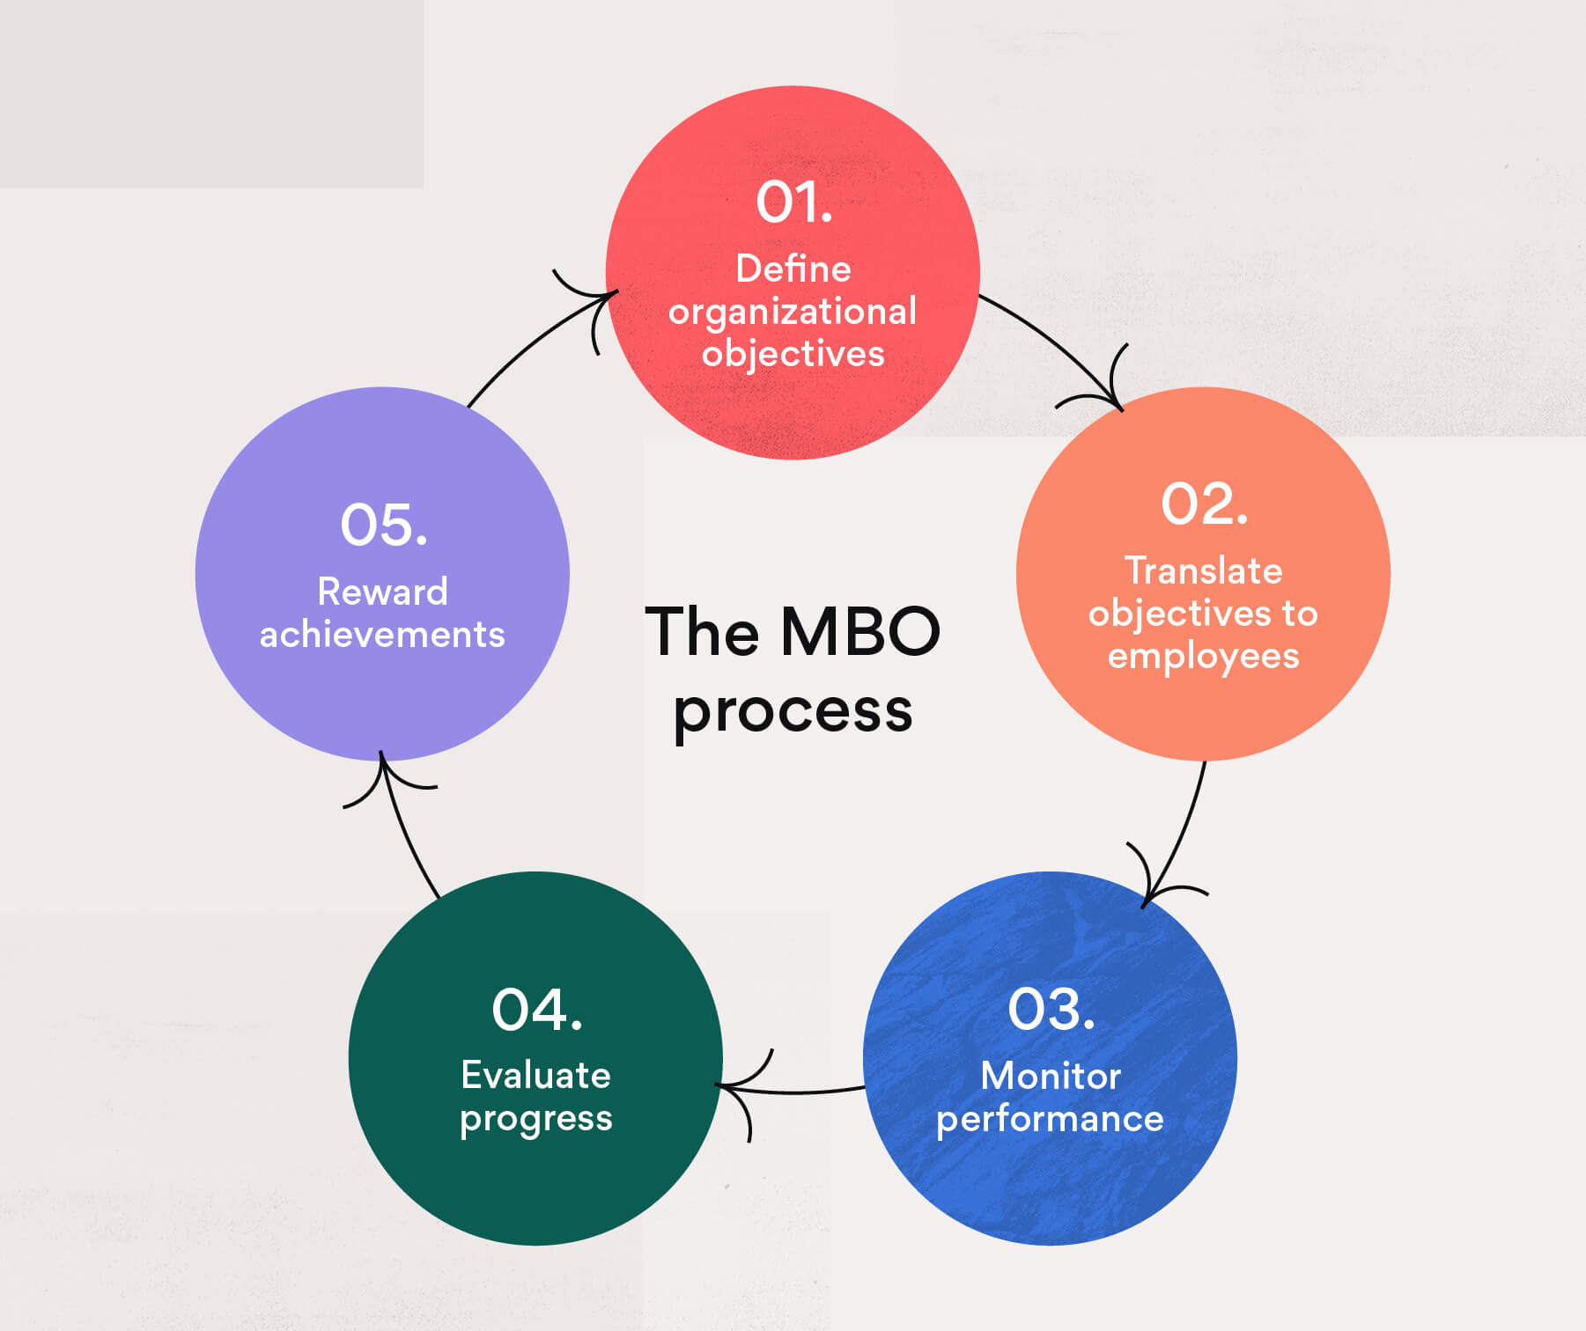
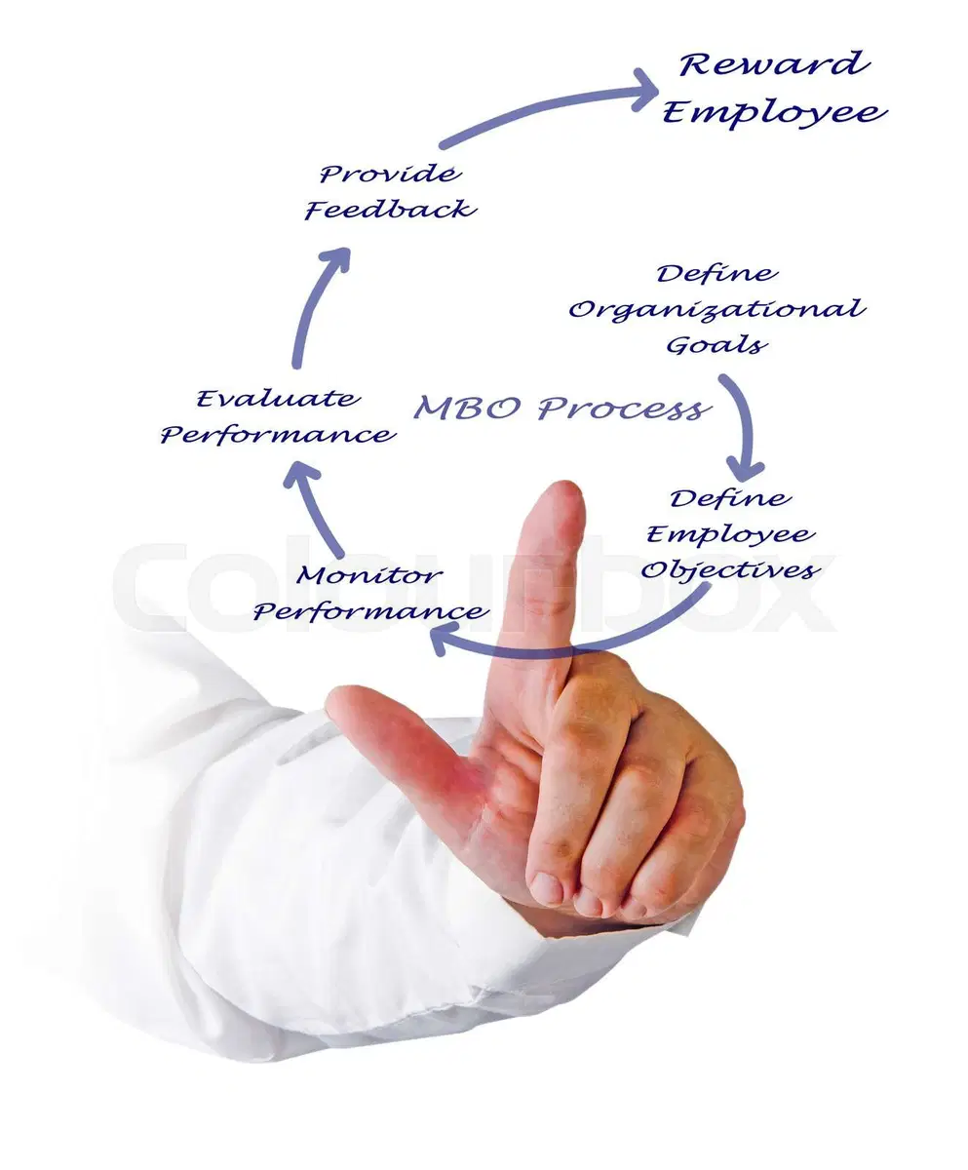
MBO Process

Slide 67
STEP 1: SETTING ORGANIZATIONAL OBJECTIVES
In the first step of MBO processing, Management by Objectives concentrates on either setting, revising or amending organizational objectives. The objectives being assessed require to be measurable and attainable. The most important factor to be considered is the relevance of the goal to the company’s ultimate mission.
STEP 2: SETTING INDIVIDUAL OBJECTIVES
The second step in MBO processing is to align the organizational objectives of the company with that of the employees. The SMART strategy will guide you through this step.
STEP 3: MEASURING PERFORMANCES
Step three is all about assessing the employees and giving them the liberty to plan their individual objectives. So far the administration did all work for them, now is the time to give them the control. This acquired ownership will give them a sense of responsibility, dedication and motivation to achieve their goals which will ultimately benefit the organization.
STEP 4: EVALUATING PERFORMANCE
In the fourth step, the emphasis is on regulating and monitoring the work progress of employees. It is aimed at ensuring that the mechanism is going smooth and the work output is on track with the formulated work structure and deadlines.
STEP 5: REWARDING EMPLOYEES
The last step is the evaluation step. Here the managers need to prepare a list of their best-performing employees and reward them for their dedication and good work. They can also prepare a list of under-performing employees and give them constructive feedback and suggestions to improve their work. This brings in healthy competition in the workspace and motivates employees to give better work results.

Slide 68
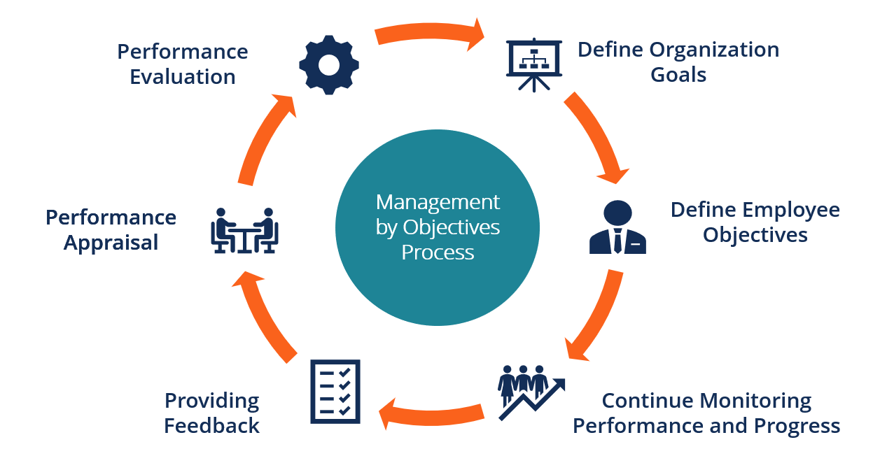

Slide 69
Objectives of Management
Make Proper Use of The Available Resources.
Ensure Business Development and Growth.
Quality Products And Services.
Availability of Goods and Services.
Ensuring Discipline in the Workplace.
Attracting the Best Candidates for the Job.
Make Futuristic Plans.
Reduce the Element of Risks.

Slide 70
Advantage of MBO
Since Management by objectives (MBO) is a result-oriented process and focuses on setting and controlling goals, if encourages managers to do detailed planning.
Both the manager and the subordinates know what is expected of them and hence there is no role ambiguity or confusion.
the responsibilities and authority of the personnel is clearly established.
It makes individuals more aware of the company goals. Most often the subordinates are concerned with their own objectives and the environment surrounding them. But with MBO, the subordinates feel proud of being involved in the organizational goals. This improves their morale and commitment.
Management by objectives (MBO) often highlights the area in which the employees need further training, leading to career development.
The system of periodic evaluation lets the subordinates know how well they are doing. Since MBO puts strong emphasis on quantifiable objectives, the measurement and appraisal can be more objective, specific and equitable.
It improves communication between management and subordinates.

Slide 71
Disadvantage
MBO can only succeed if it has the complete support of the top management.
Management by Objectives (MBO) may be resented by subordinates. They may be under pressure to get along with the management when setting goals and objectives and these goals may be set unrealistically high. This may lower their morale and they may become suspicious about the philosophy behind MBO.
They may seriously believe that MBO is just another of the management’s ploys to make the subordinates work harder and become more dedicated and involved. The emphasis in the MBO system is on quantifying the goals and objectives. It does not leave any ground for subjective goals. Some areas are difficult to quantify and even more difficult to evaluate.
There is considerable paperwork involved and it takes too much of the manager’s time. Too many meetings and too many reports add to the manager’s responsibility and burden. Some managers may resist the program because of this increased paperwork.

Slide 72
Management by exception
Management by exception (MBE) is a style of business management that focuses on identifying and handling cases that deviate from the norm, recommended as best practice by the project management method. Management by exception has both a general business application and a business intelligence application.
Management by exception' is an important principle of control, which propagates that only significant deviations which goes beyond the permissible limit should be brought to the notice of management, as an attempt to control everything, results in controlling nothing.
Management by exception (MBE) is a management strategy in which managers will only step in when there are significant deviations from planned outcomes. These can be either operational or financial outcomes.

Slide 73


Slide 74
1 Setting of Objectives or Norms – The process of management by exception starts with setting up of the standard norms of the business.
2. Assessing the performance and comparing it with the norm – Once the norms have been set up, in the next step, the management needs to use the technique of management by exception. The reason is that, it is the most vital part of the process as it compares and assesses whether the actual performance of the business is matching with the set of norms or not. It is done by the management of the business to identify the area of deviations so that the measures are taken by the business itself to deal with that deviation.
In this step, monitoring of the relevant data is also done by the management. The process of monitoring depends upon the nature of the business like how big your company is and what type of data is monitored by the business.
3. Comparison – After the assessment, compare the actual result with the standards.
4. Analyzing the Deviation - After the comparison of the performance and data, we get two possible outcomes:
No significant Deviation – It means the deviation is very minor which may not affect the objective of the business. Therefore, the company cannot take any action against this deviation.
Significant deviation – It means the deviation is major in nature and the manager has to bring the deviation in the attention of high-level management. As a result, the management of the company will be able to respond against this deviation.
5. Solving the Exception – After analyzing the deviation, it becomes the responsibility of the management to deal with that deviation. Before taking appropriate action to solve the deviation, first understand what the reason behind the deviation is. As a manager, you need to know about the root cause of the deviation so that the correct action is taken based on those factors which can help in solving the deviation immediately.

Slide 75
Advantages of MBE
Management by exception provides the following benefits:
It saves the time of managers because they deal only with exceptional matters. ...
It focuses managerial attention on major problems. ...
It facilitates delegation of authority. ...
It is a technique of separating important information from unimportant one.

Slide 76
Disadvantages of management by exception:
Following management by exception increases the workload of subordinates.
It is difficult to differentiate between the exceptional and non-exceptional areas of the organization.
It requires continuous observing and reporting to the management.
There can be a deviation due to human behavior. Such deviation is difficult to identify and correct.

Slide 77
Applications of management by exception:
Management by exception is applied in large organizations where the delegation of authority is possible.
Management by exception is applied for identifying the reason for the deviation of performance from the set standards.
The technique of management by exception is useful for the management in taking decisions for long term survival and future growth of the organization.

Slide 78
Contemporary issue of leadership in Nepali Organizations
Emotional Intelligence and Leadership
Moral Leadership
Team Leadership
Cross-Culture Leadership
Mutual Influence

Slide 79
Emotional intelligence and leadership
The emotional intelligence is concerned with self awareness, self management, self motivation, social skill, sympathy etc. Recent evidence suggest that emotional intelligence is positively related to job performance. It is essential element in leadership effectiveness.
Moral leadership
This issue is consideration of ethical implication power showing in leadership. The moral content of goals need to be considered for judging leadership effectiveness. Honesty and integrity are important in leadership. The issue of ethical leadership is getting important.

Slide 80
Team Leadership
This issue is concerned with the challenges of being an effective team leader. Teams are growing popularity. Leadership is increasingly taking place within a team context. Team leaders need to manage stakeholders and facilitates the team process. The team leader performs the role of liaison with stakeholder, troubleshooter, conflict manager, coach, etc.
Cross culture leadership
This issue focus that culture is an important situational factor determining leadership style. Leaders are constrained by the expectation of culture condition of their followers. They cannot choose their own style without considering cultural value of others. Most leadership theories ae develop in western European countries.it is the reason that they have cultural biasness. They need to be adjusted to suit national culture.

Slide 81
Mutual influence
This issue consider that nature influence on behavior of the leader and followers shows the leadership effectiveness. Leader and followers interact with one another. Leader influence followers and followers also influence leader. It implies mutual influence.

Slide 82
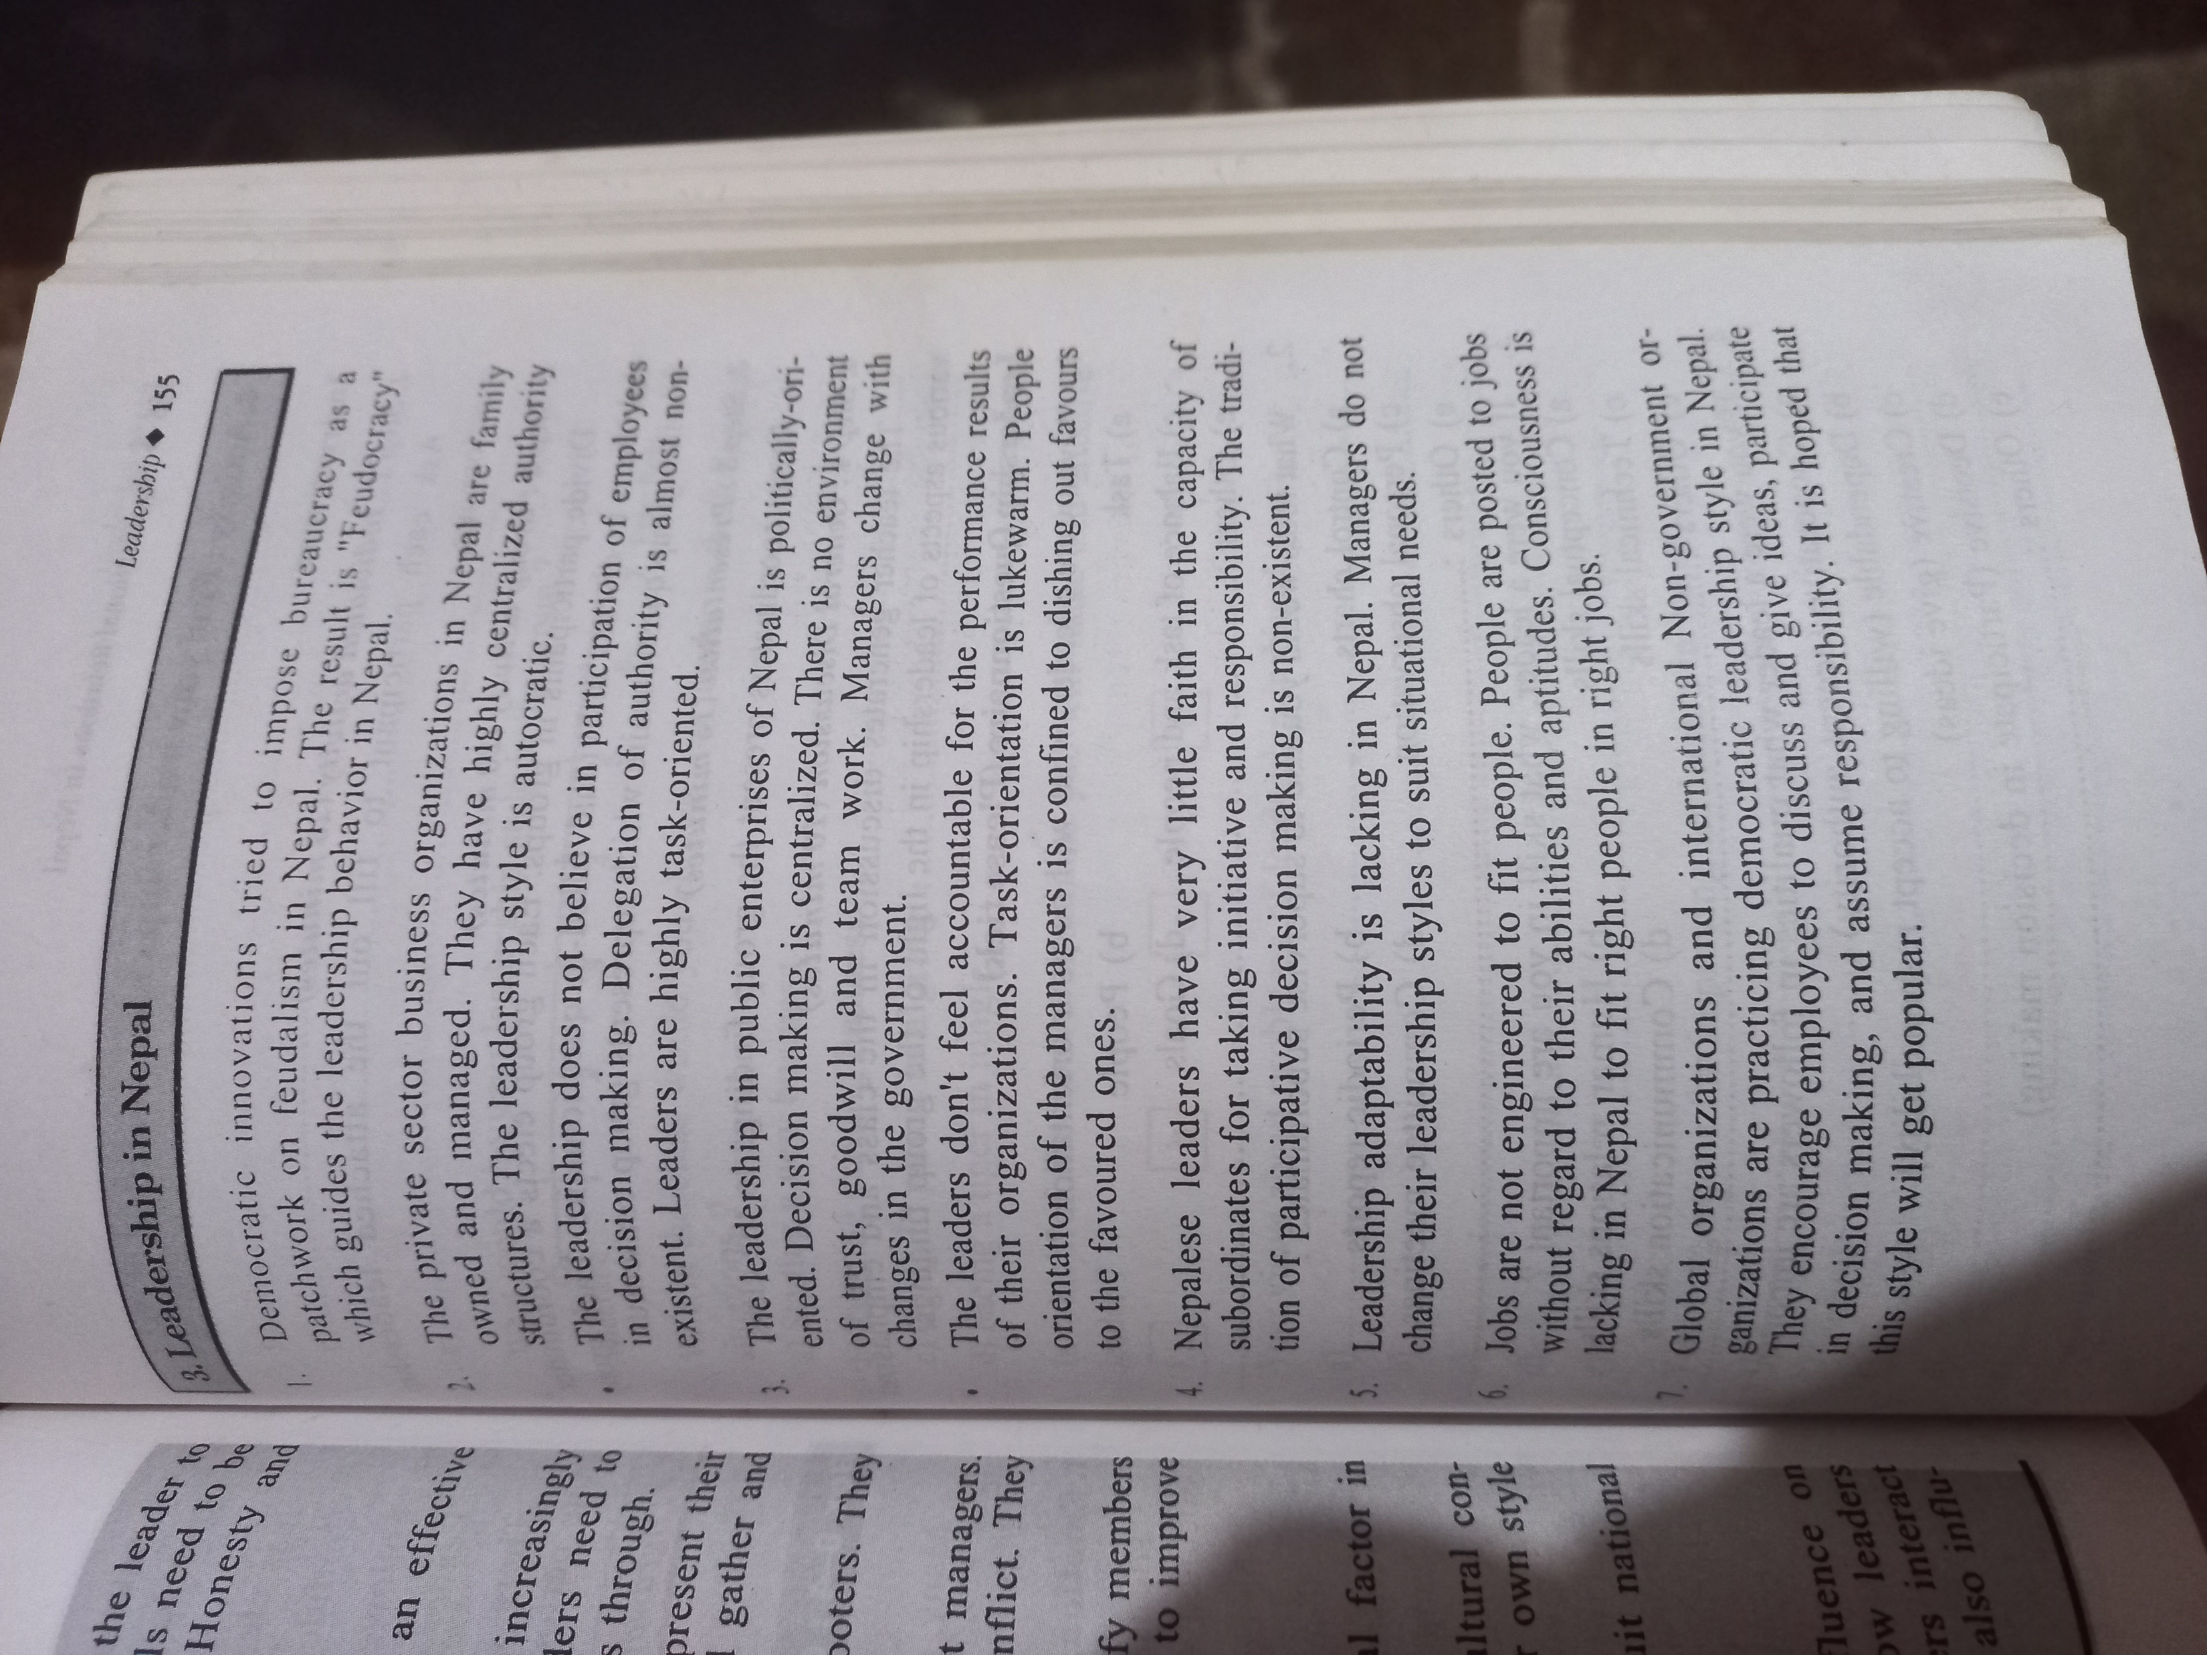

Slide 83
Case study tomorrow class discussion
https://www.studocu.com/ph/document/aklan-state-university/business-administration/case-study-3-management-and-motivation/11874274
https://www.studocu.com/ph/document/aklan-state-university/business-administration/case-study-1-leadership-and-management/11874273

